Slide 1
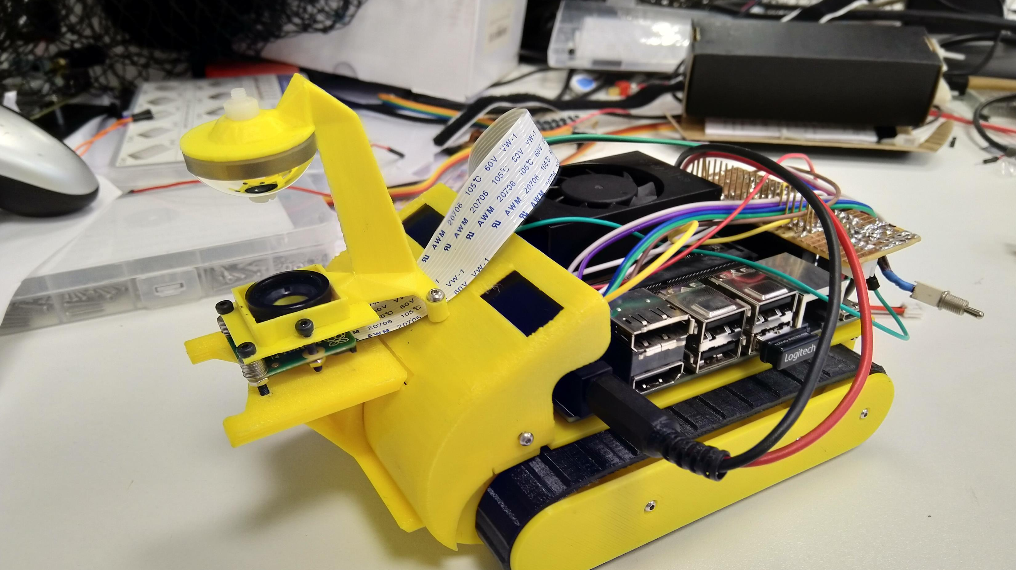
Junior Research Associate
Dexter R Shepherd

Slide 2
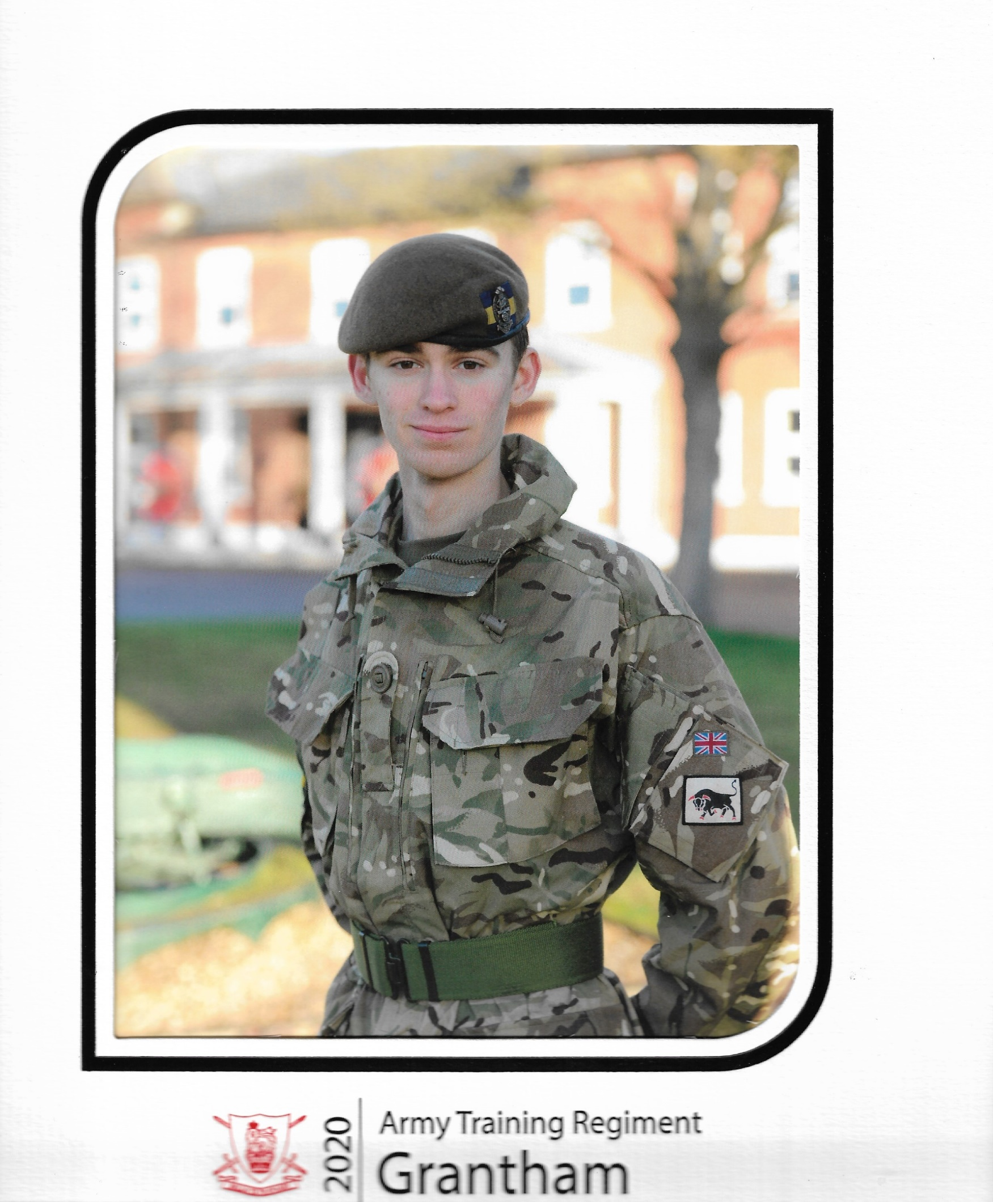
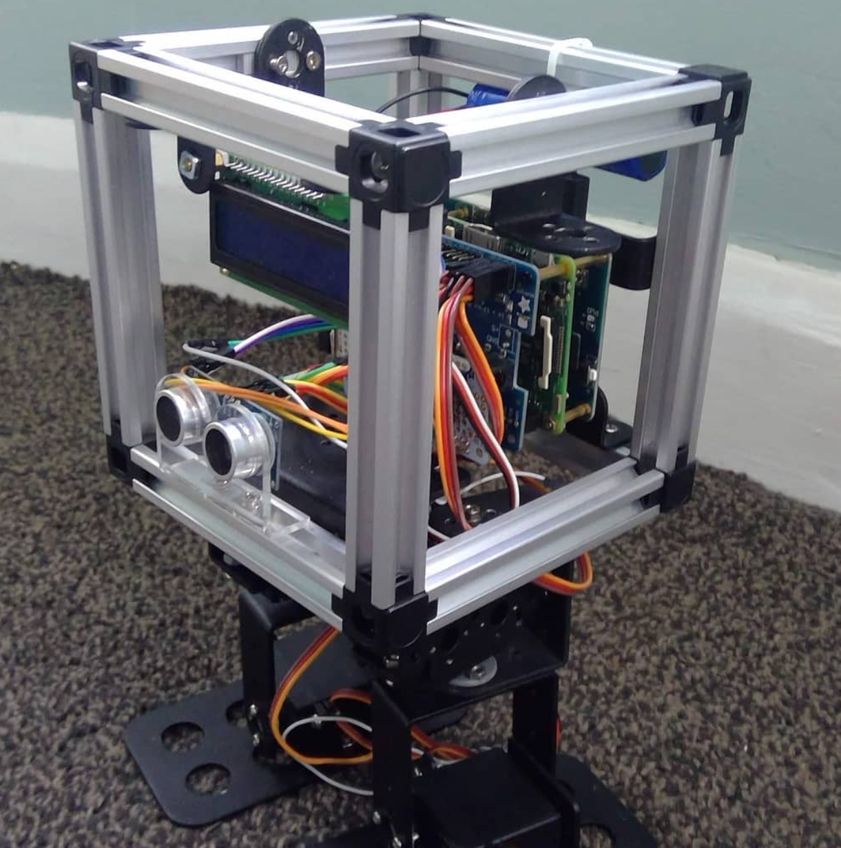
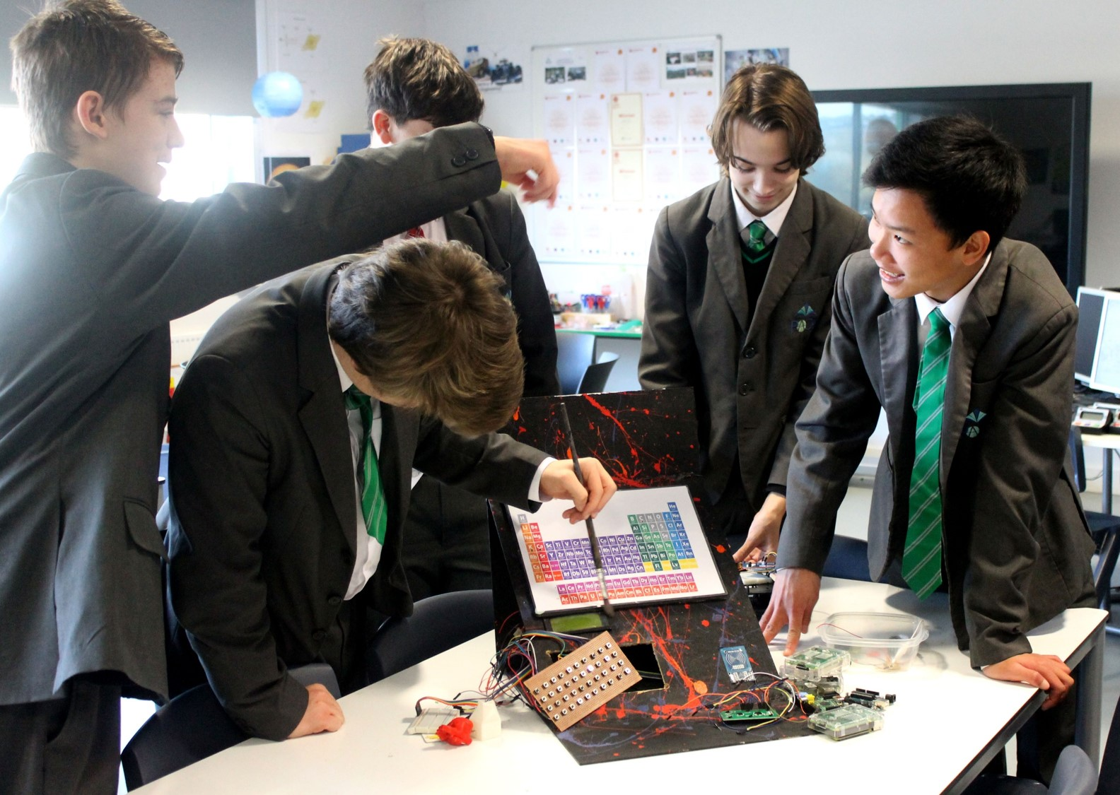
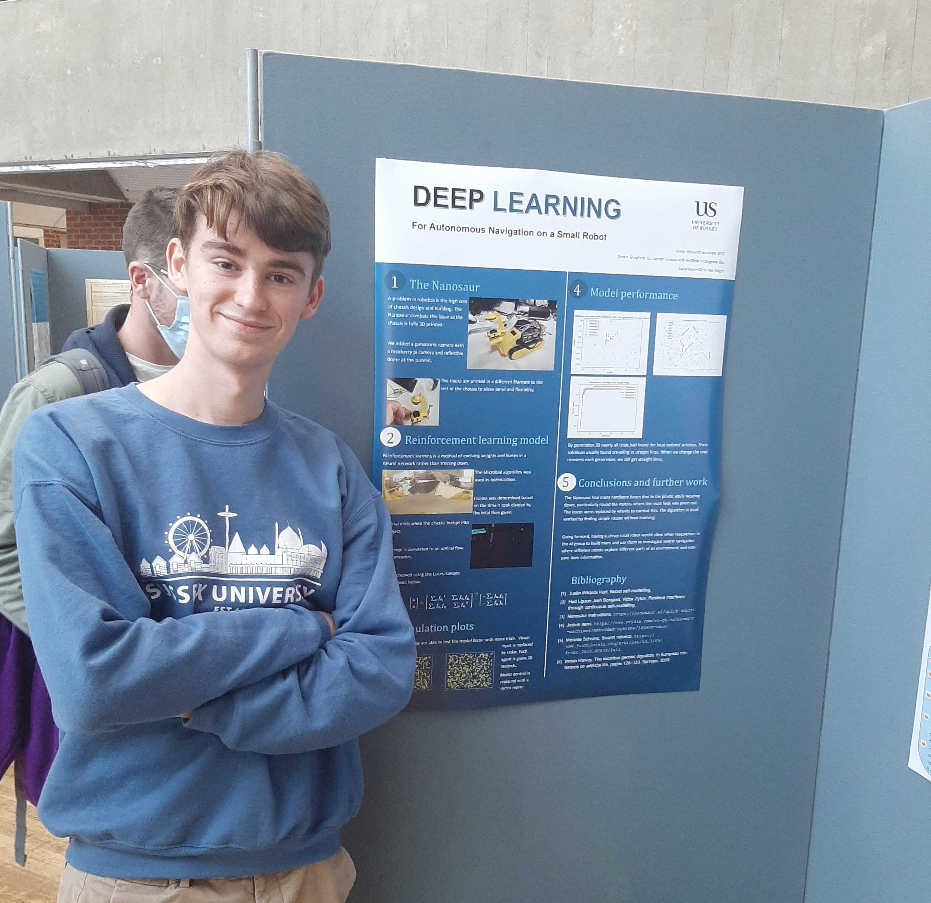
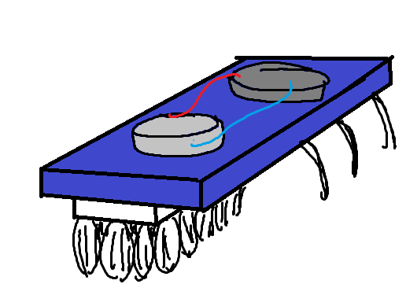
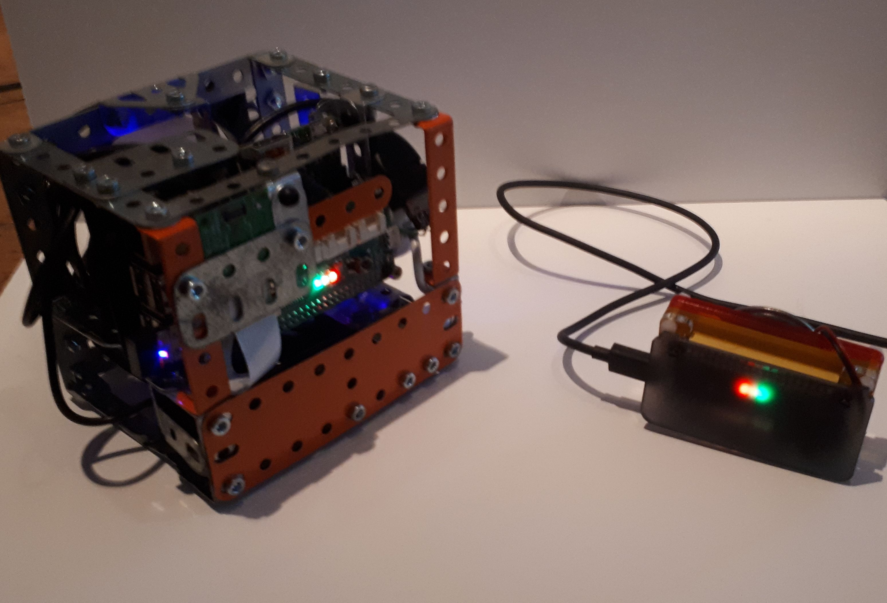
Background (summary)
2014
2016
2019
2021
2014
2015
2018
2021

Slide 3
My JRA Project – Deep Learning For Autonomous Navigation on a Small Robot
3D printed chassis
Small robot
Evolved navigation
Making use of the Jetson

Slide 4
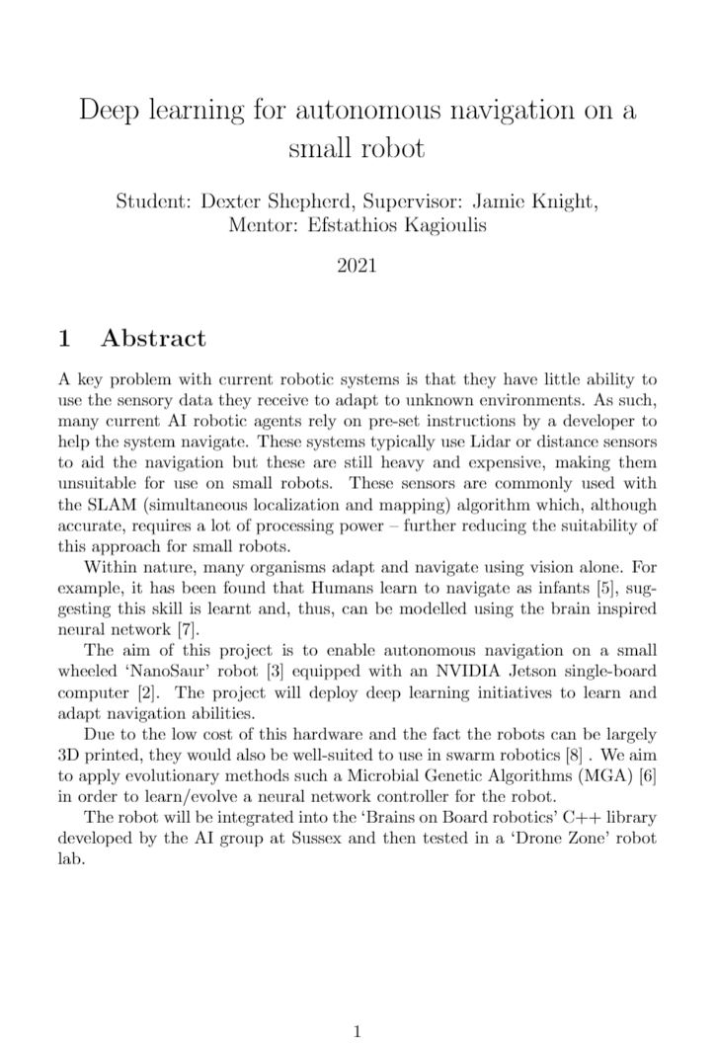
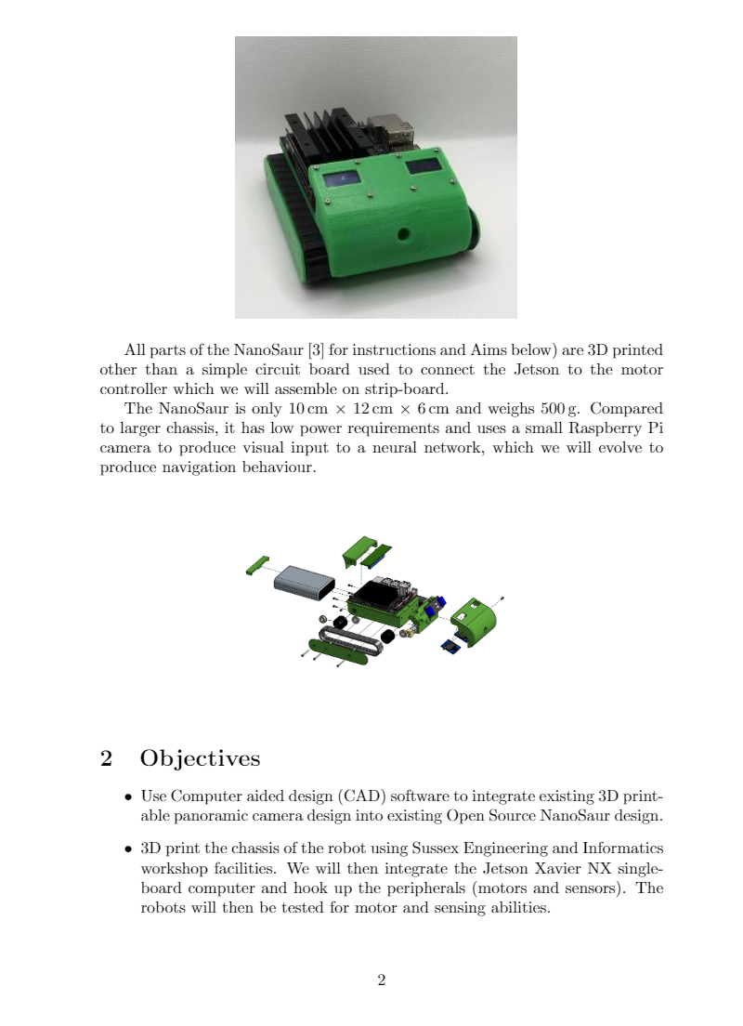
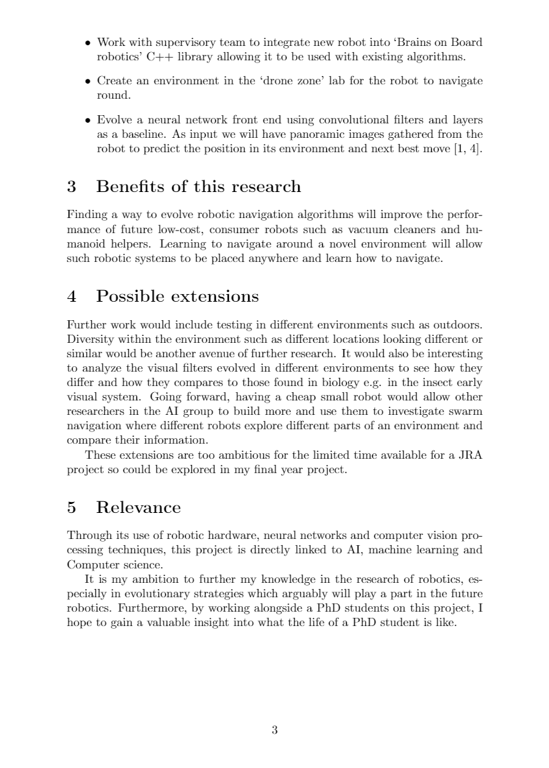
Proposal

Slide 5
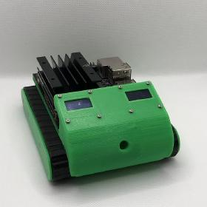
The Nanosaur
Open source chassis for Brains on Board robotics
The “Brains on Board” team supports open-access publishing and aims to share and disseminate outcomes to researchers and the public alike

Slide 6
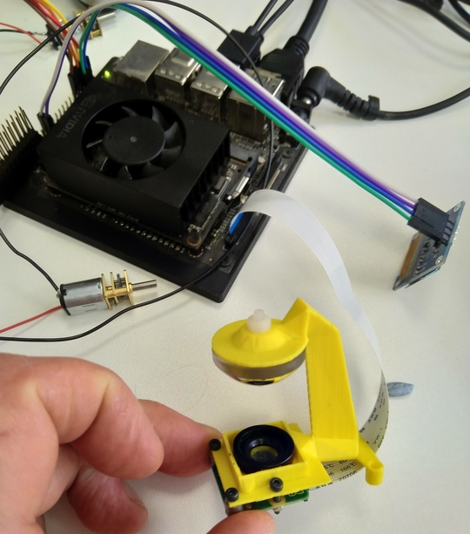
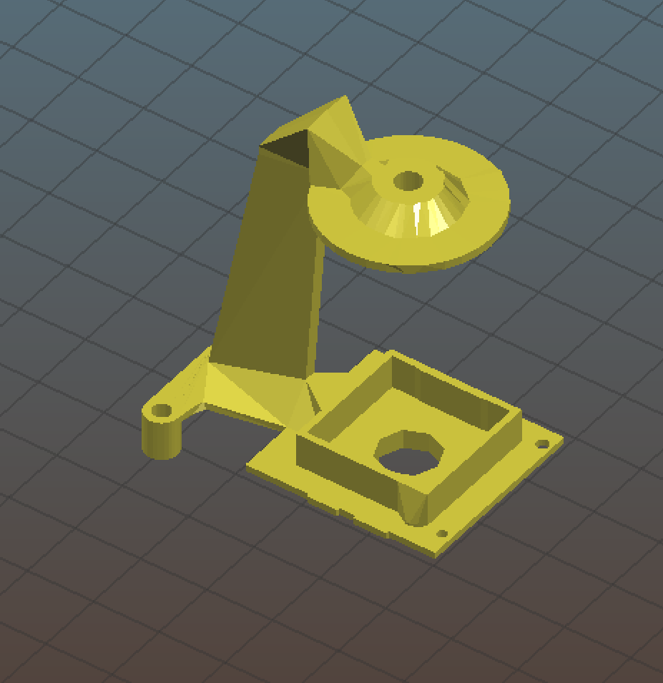
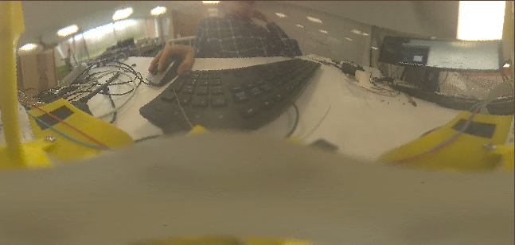
Panoramic module

Slide 7
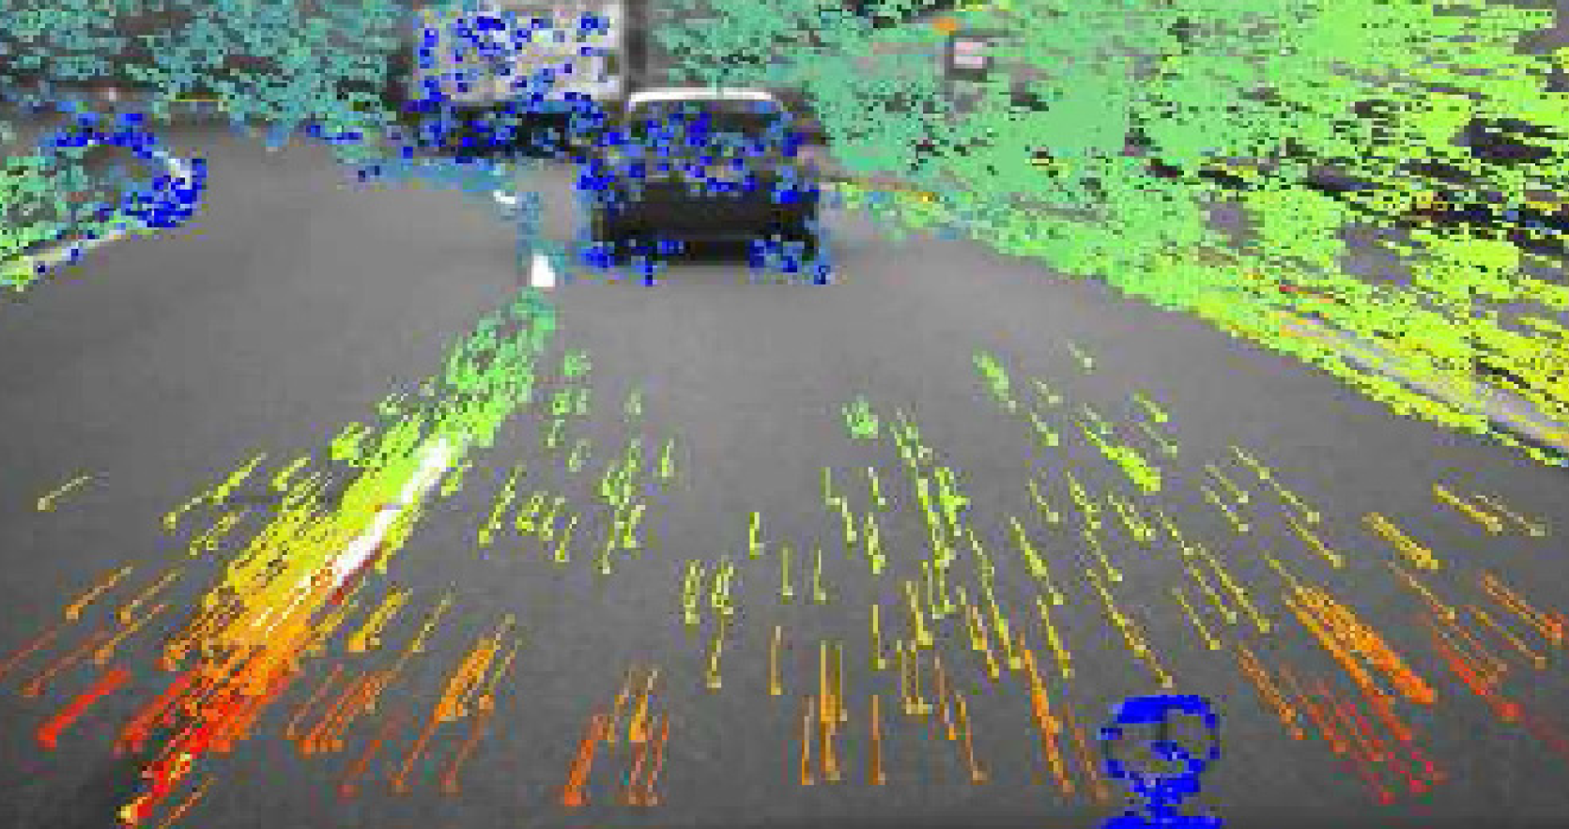
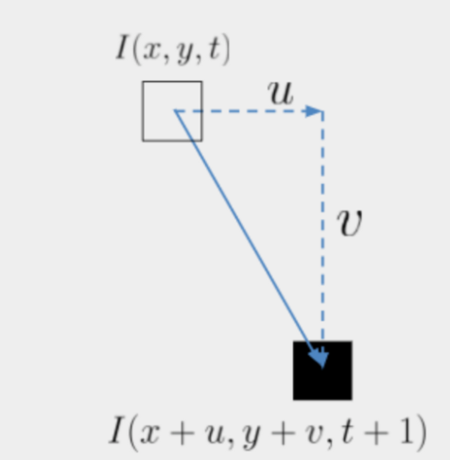
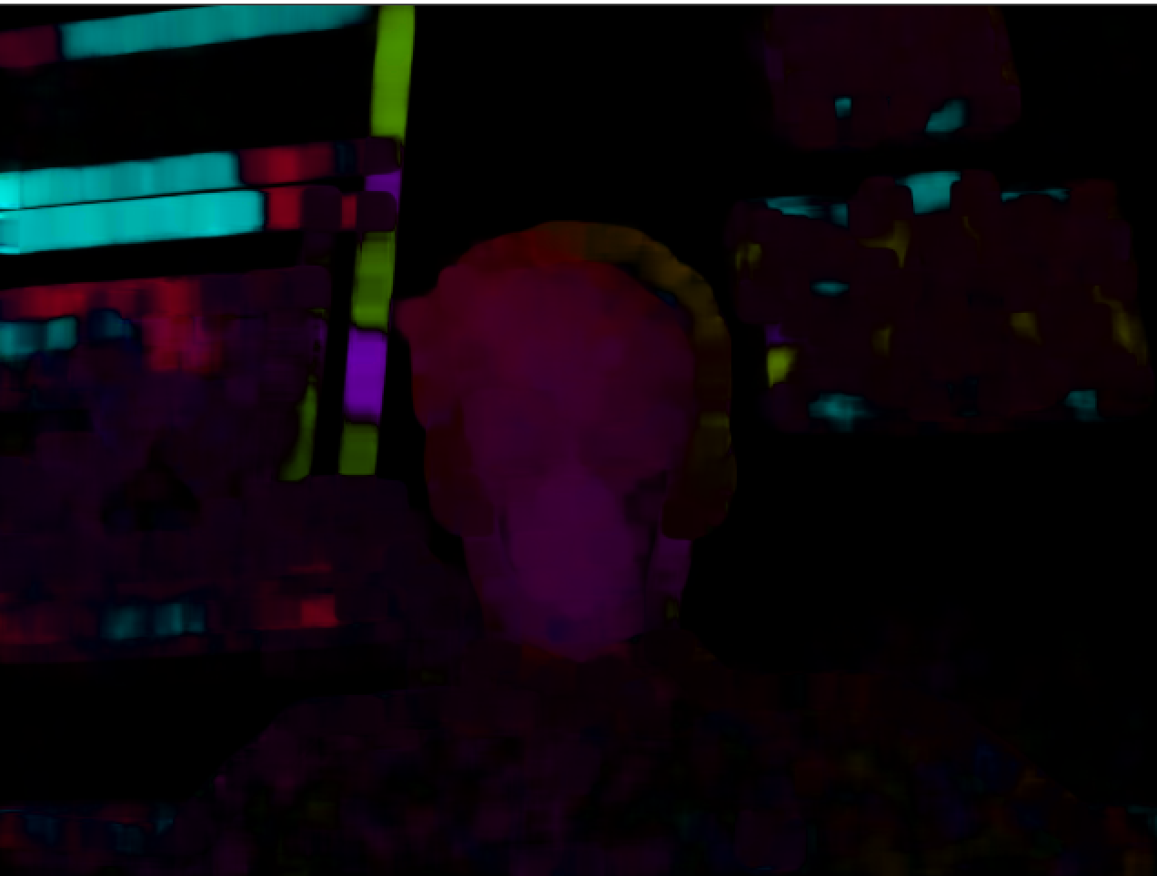
Computer vision
Bio-inspired - optic flow fields

Slide 8
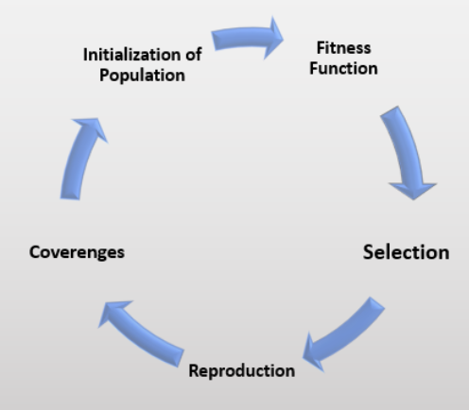
Genetic algorithms
Mutating genotypes (encoded information) and evaluating fitness

Slide 9
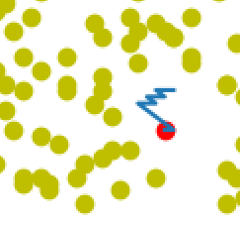
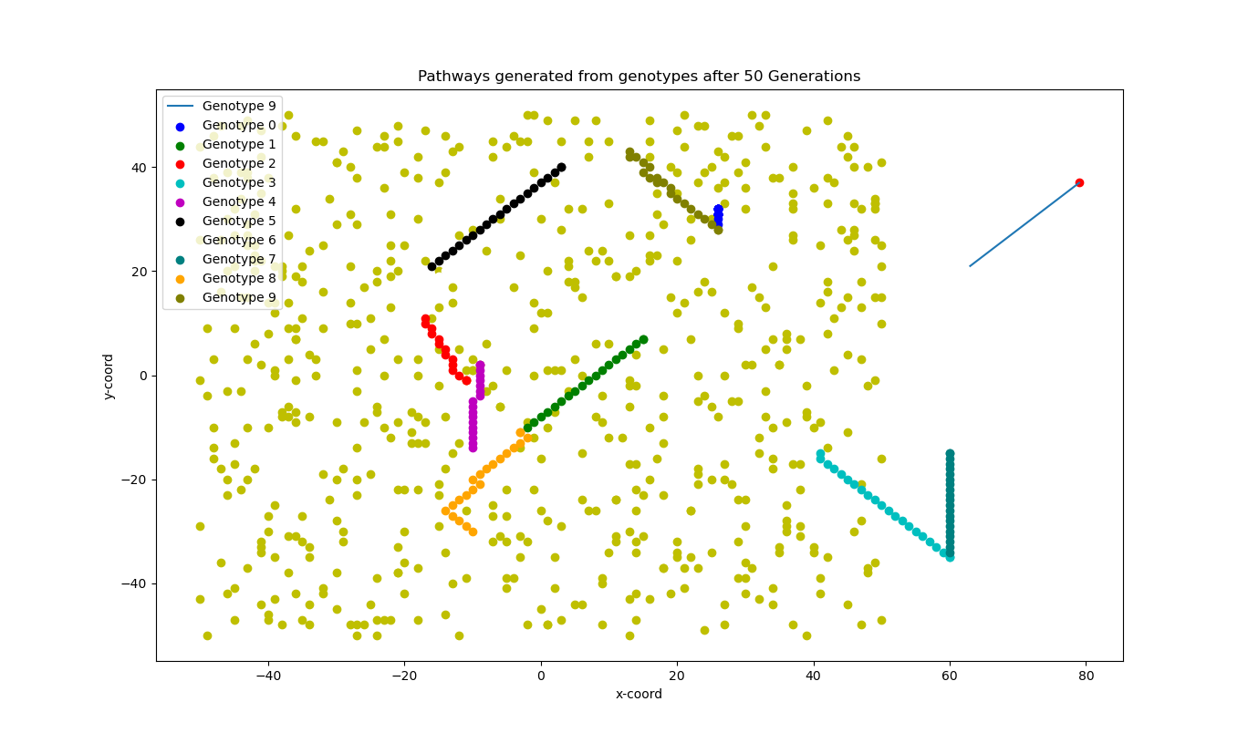
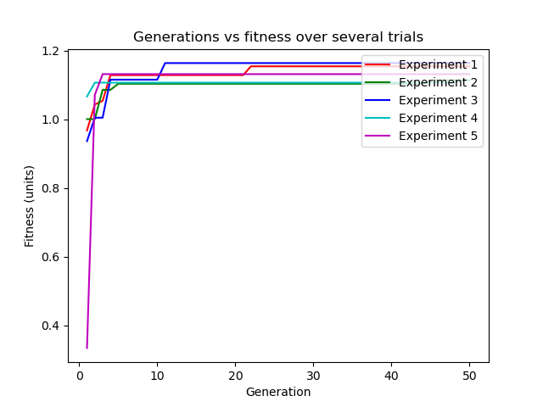
Simulation trials
Agents evolved to avoid obstacles
Some agents evolved to cheat!

Slide 10
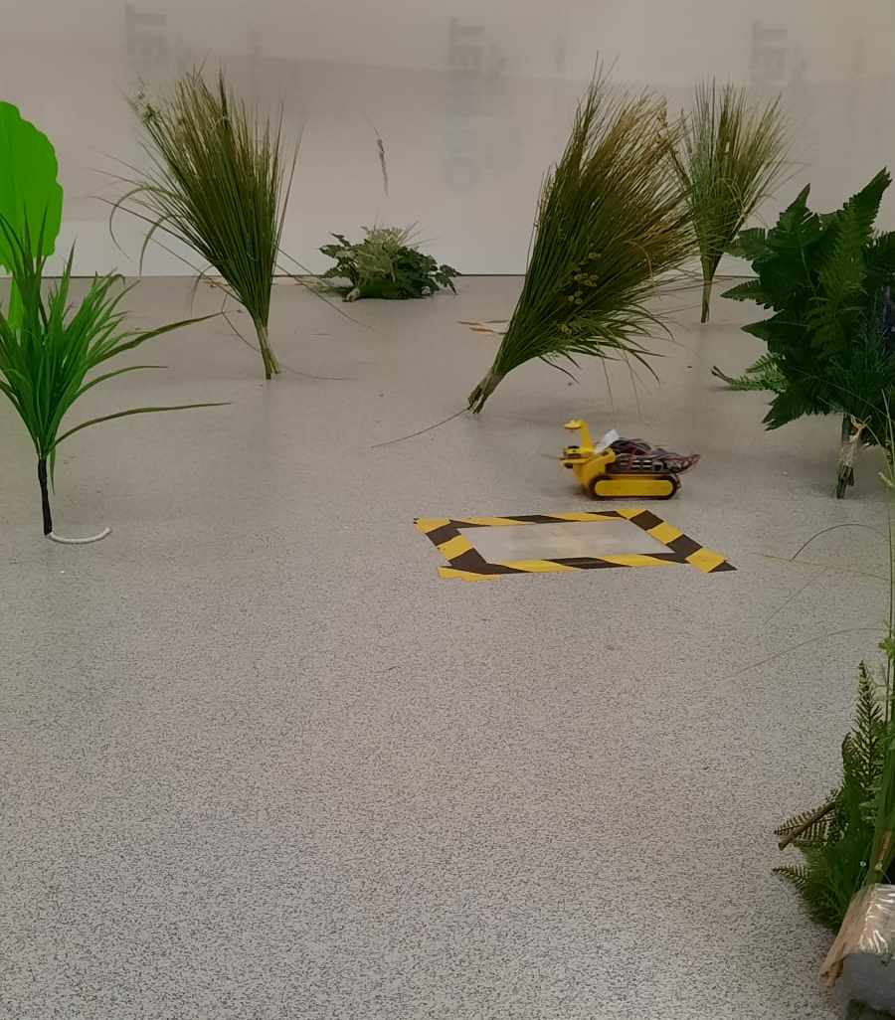
Physical trials

Slide 11
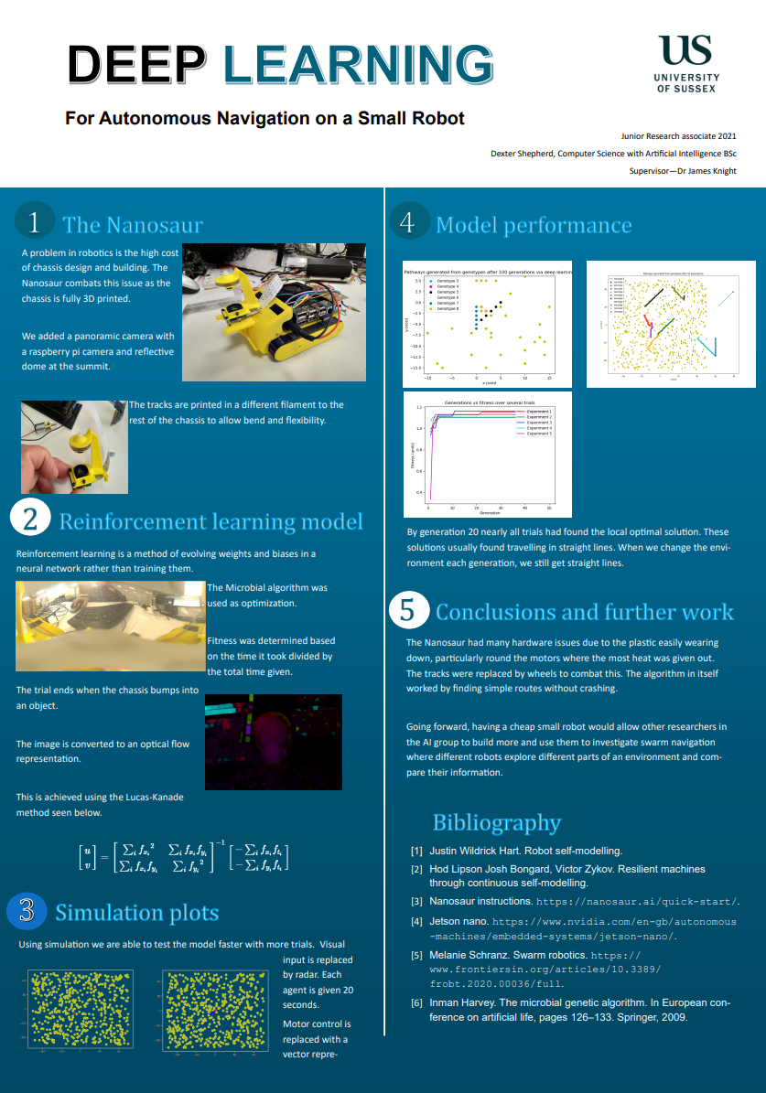
Conclusions
Evolved evolution through computer vision has a large search space -> takes a long time to converge
Simulation proof of concept
3d printed chassis are cheaper, but wear down quicker

Slide 12
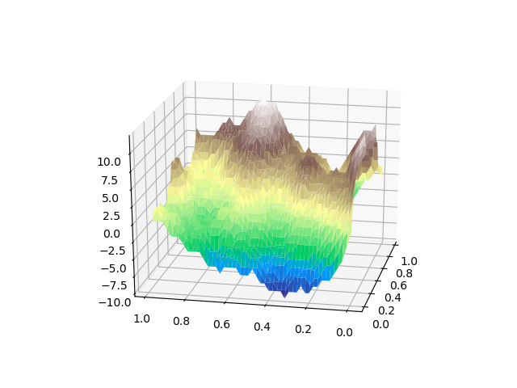
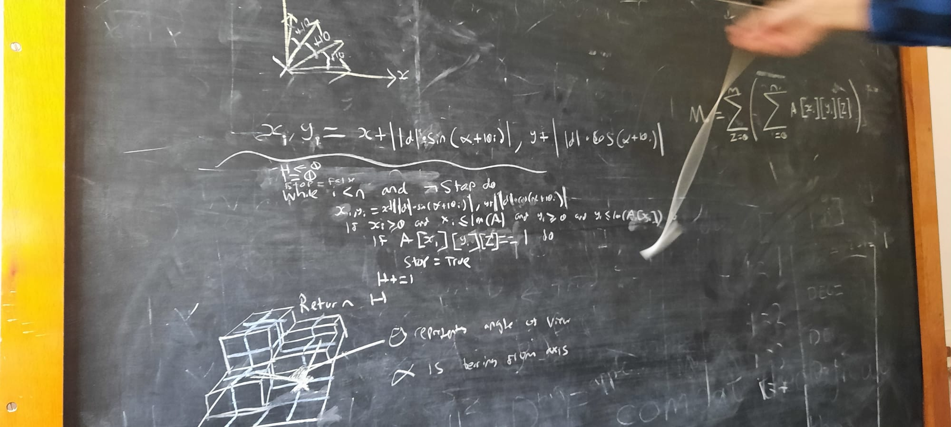
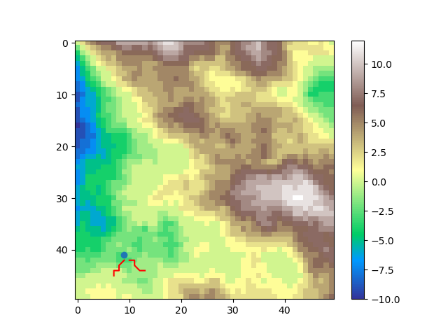
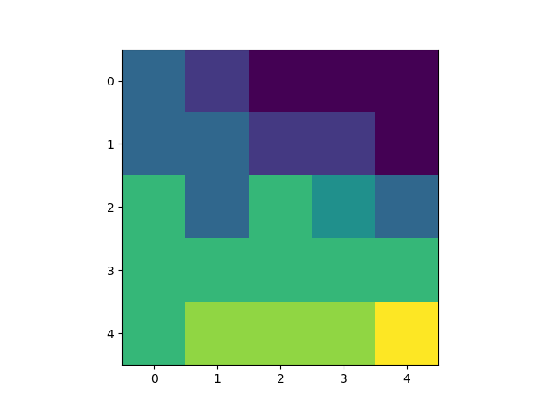
Future work (final year project)
WHEGS

Slide 13
My advice
Find a supervisor who shares your interests
Find a supervisor you can work well with
Don’t attempt something too far out of your scope
Be ambitious but remember its only 8-weeks

Slide 14
References
[1] Justin Wildrick Hart. Robot self-modelling.
[2] Hod Lipson Josh Bongard, Victor Zykov. Resilient machines through continuous self-modelling.
[3] Nanosaur instructions. https://nanosaur.ai/quick-start/.
[4] Jetson nano. https://www.nvidia.com/en-gb/autonomous -machines/embedded-systems/jetson-nano/.
[5] Melanie Schranz. Swarm robotics. https:// www.frontiersin.org/articles/10.3389/ frobt.2020.00036/full.
[6] Inman Harvey. The microbial genetic algorithm. In European commission on artificial life. Springer, 2009

