Slide 1
Report writing and Overleaf
Mae Schreiner and Rehan Zuberi

Slide 2
Sections of a report
Abstract
Introduction / context
Methods
Results / interpretation
Discussion
Conclusion
Appendix
Everywhere:
Diagrams
Citations

Slide 3
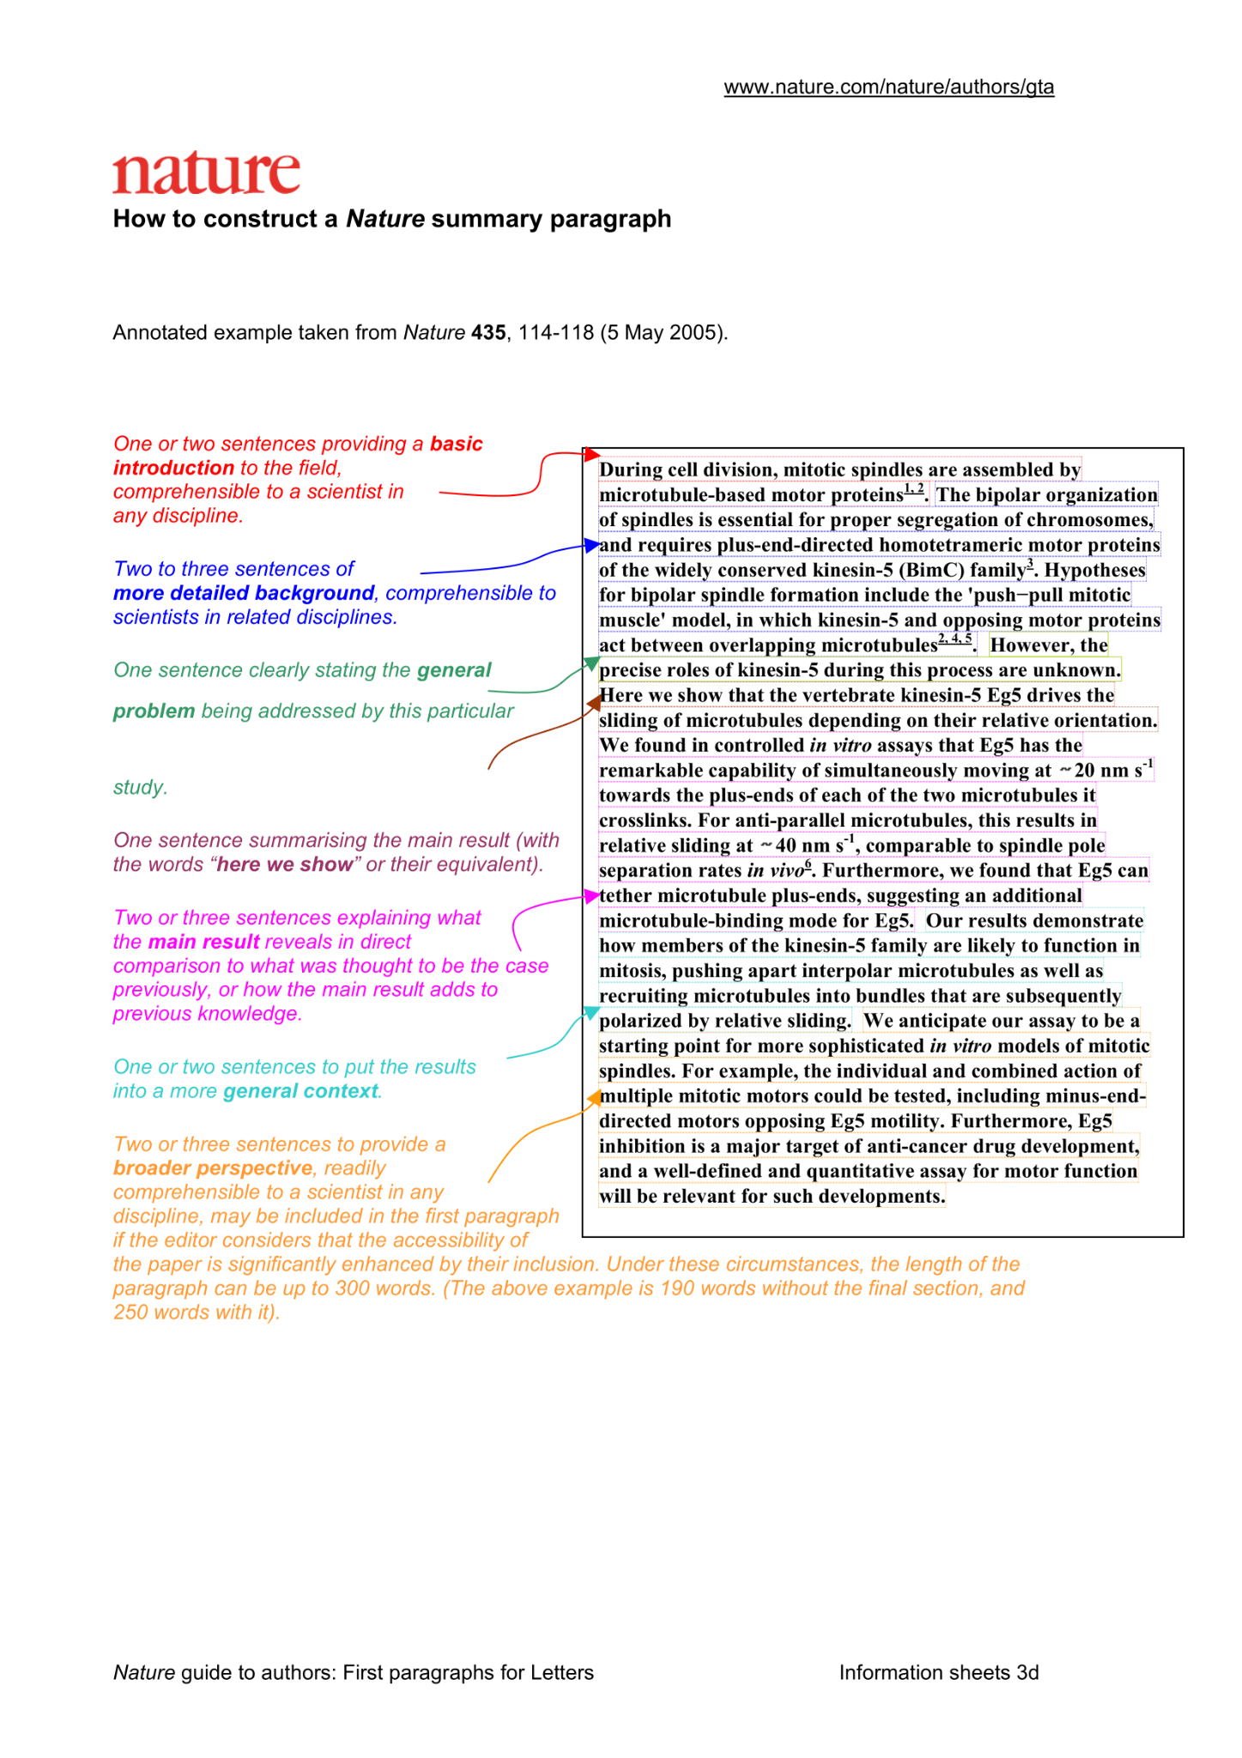
The abstract section
A summary of the entire report in 12 sentences
Can I get an overview of everything in this, minus the details, of the context, methods, results and implications?

Slide 4
The Introduction section
Definitions
What is the context?
What are we doing?
Why are we doing this?
How is it organised?
What is the hypothesis?
What were the results?
Difference from abstract:
More context
More details

Slide 5
Methods
Detailed steps you used to get your results
Include flowcharts, pseudocode, formulas
Talk about Null hypothesis and what can be inferred from the results

Slide 6
Results
In the same order as the methods, what are the results?
What can we infer from them?
What do these results not say?
How confident are we about these?

Slide 7
Discussion
Self evaluation and mistakes reporting
What went wrong?
Which methods did not work?
Which methods gave us unsatisfactory results?
How could we extend our research?

Slide 8
Conclusion
Rephrase introduction
State result of hypothesis
Talk about the results and their impact
Some outlook where these results and insights can lead

Slide 9
Citations
Use a citation manager: Zotero, MyBib
Comes after the conclusion and before the appendix
When in doubt: cite
Good strategy: put your report in the draft Turnitin and cite whatever is highlighted as plagiarised to catch whatever you forgot

Slide 10
Appendix
Always optional, never counts towards the grade
The diagrams you did not use but can be useful
The bits of text and context that are too detailed to be included without cluttering
The results from certain methods that were not taken into account
Very rarely read, good for you for future reference

Slide 11
Types of diagrams
What do I want to say that will be more expressive visually?
Only put important stuff in diagrams
Do not overdo it, too many diagrams takes away from the value of other diagrams
With Python, use Matplotlib and Seaborn to make them pretty
Don’t only plot results in graphs: flowcharts for methods, heathmaps for trends, etc.
Use arrows, name axes, add labels, colour code, etc.
A diagram has to be precise and clear

Slide 12
Overleaf
How referencing works (BibTex file)
Pseudocode
How to reference images
Sections

