Slide 1
PAL Math Workshop
Statistics

Slide 2

Statistical Average: Mean vs. Median
Example: $x_{i}=\left\{2,9,10,12,12,113\right\}$
Mean:
-> $\overline{x}=\frac{\left(2+9+10+12+12+113\right)}{6}=26.3$
Median:
Middle value in a sorted collection -> $\left\{2,9,10,12,12,113\right\}$ = 11
*The median average can be preferable when there are outliers

Slide 3
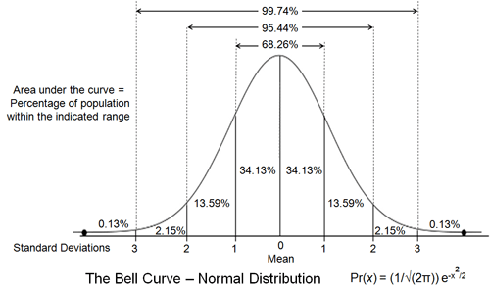
Normal (Gaussian) Distribution
“Area under curve adds up to 1”
* $≈68\%$ of the data points are distributed within $±1σ$ from the mean

Slide 4
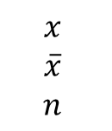
Standard Deviation
$$x$$
$$\overline{x}$$
$$n$$
-> element in a data set
-> the mean of all the elements in the data set
-> the total number of elements in the data set
$$σ=$$
Interpreting Standard Deviation:
Low $σ$ -> the elements are distributed closely to the mean $\overline{x}$
High $σ$ -> the elements are more spread out from the mean $\overline{x}$
*Note: variance is $σ^{2}$ -> square of the standard deviation

Slide 5

Binomial Distribution - Formula
$$X\sim B\left(n,p\right) ⇒P\left(X=k\right)=\left(\begin{aligned}n \\ k\end{aligned}\right)⋅p^{k}⋅{\left(1−p\right)}^{n−1}$$
$n$ -> number of trials
$k$-> number of successes
$p$ -> probability of success on one trial
$\left(1−p\right)$-> probability of failure on one trial
* ”Binomial Distribution” -> only two possible outcomes: success or failure

Slide 6
Null-Hypothesis H₀
Naïve by only considering pure chance
Definition: “A null hypothesis is a hypothesis which proposes that there is no difference between certain characteristics of a population or data-generating process.”
Example:
Null-Hypothesis H₀ : 50:50 chance of winning/losing in a chess game
*commonly used in hypothesis testing
disregarding the fact that some people are more skilled and, therefore, more likely to win…

Slide 7
Hypothesis Testing
Formulate Null-Hypothesis
Calculate the Probability Distribution $P\left(X=k\right)$
Compare Results to Significance Level $α$
Reject or Not Reject the Null Hypothesis
We can only ever ‘Reject’ or ‘Not Reject’ our Null-Hypothesis when comparing it to the Significance Level $α$

Slide 8
Hypothesis Testing Example – Tic-Tac-Toe:
Observation: you are playing tic-tac-toe with a friend and observe that she wins 8 out of 10 games.
Null-Hypothesis: she has a chance of 50% to win (pure chance)
Binomial Probability Distribution: $X\sim B\left(n,p\right) ⇒P\left(X=k\right)=\left(\begin{aligned}n \\ k\end{aligned}\right)⋅p^{k}⋅{\left(1−p\right)}^{n−1}$
$$X\sim B\left(10, 0.5\right)⇒P\left(X≥8\right)=\left(\begin{aligned}10 \\ 8\end{aligned}\right)⋅{0.5}^{8}⋅{\left(1−0.5\right)}^{10−1}$$
$$P\left(X≥8\right)=0.000343$$
Comparison ($α$= 0.05): 0.000343 < 0.05
Conclusion:
Rejection of Null-Hypothesis -> the probability 𝑃 of obtaining this observation, or a more extreme observation if the null-hypothesis were true is significantly unlikely

