Slide 1
Proof by Induction

Slide 2
*L.H.S – ‘left hand side’
Proof by Induction – Three Step Theory
Step 1 - BASE CASE
substitute $n$= 1 or $n$ = 0 for $n$
Step 2 - ASSUMPTION
formulate assumption that claim is true for $n$
Step 3 - INDUCTION STEP
substitute ($n$+1) for all $n$ and evaluate both *L.H.S and R.H.S to show they are equivalent
q.e.d
BASE CASE
ASSUMPTION
INDUCTION STEP

Slide 3
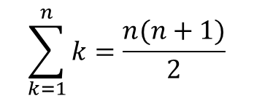
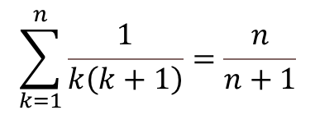
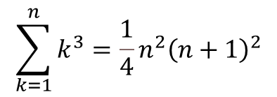
Proofs – Practice Questions
$$\sum_{k=1}^{n}{\frac{1}{\left.k ( k+1\right)}=\frac{n}{n+1}}$$
$$\sum_{k=1}^{n}{k\left(3k−1\right)=n^{2}(n+1)}$$
Question 1 :
Question 3 :
$$\sum_{k=1}^{n}{k=\frac{n(n+1)}{2}}$$
$$\sum_{k=1}^{n}{k^{3}={\frac{1}{4}n}^{2}{\left(n+1\right)}^{2}}$$
Question 2 :
Question 4 :

Slide 4
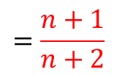
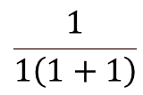
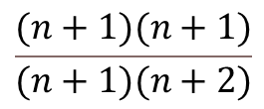
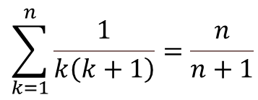
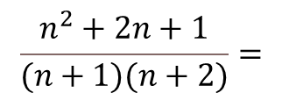

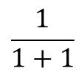

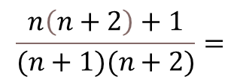
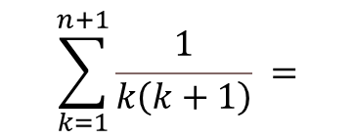
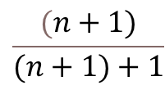
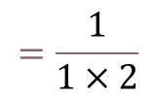
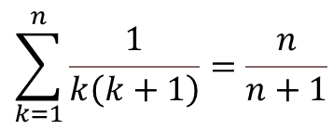
$$\sum_{k=1}^{n}{\frac{1}{\left.k ( k+1\right)}=\frac{n}{n+1}}$$
Step 3 – Induction Step: 𝑛 - > 𝑛 + 1
Question 1 :
LHS:
$$\sum_{k=1}^{n+1}{\frac{1}{\left.k ( k+1\right)} =}$$
$$(\sum_{k=1}^{n}{\frac{1}{\left.k ( k+1\right)})}$$
$$+ \frac{1}{(n+1)(n+1)+1)}$$
$$=$$
Step 1 – Base Case: n=1
LHS:
$$\frac{n}{n+1}$$
$$+ \frac{1}{(n+1)((n+1)+1)}=$$
$$\frac{1}{\left.1 ( 1+1\right)}$$
$$=\frac{1}{1×2}$$
$$=\frac{1}{2}$$
$$\frac{n\left(n+2\right)+1}{(n+1)(n+2)}=$$
$$\frac{n^{2}+2n+1}{(n+1)(n+2)}=$$
RHS:
$$\frac{1}{1+1}$$
$$=\frac{1}{2}$$
$$\frac{(n+1)(n+1)}{(n+1)(n+2)}$$
$$=\frac{n+1}{n+2}$$
True for $n$=1
Step 2 – Assumption:
RHS:
We assume that the claim is true for $n$ as the claim was true for $n$ = 1
$$\frac{(n+1)}{(n+1)+1}$$
$$=\frac{n+1}{n+2}$$
$$\sum_{k=1}^{n}{\frac{1}{\left.k ( k+1\right)}=\frac{n}{n+1}}$$
LHS is equivalent RHS.
By proof of induction the claim is true for all $n →$ q.e.d.

Slide 5
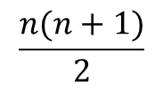

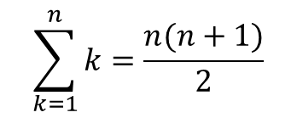
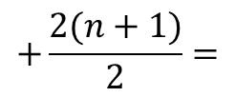
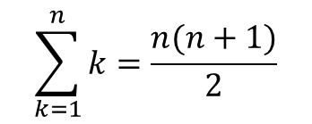

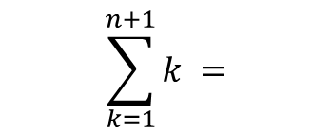
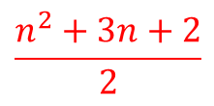
$$\sum_{k=1}^{n}{k=\frac{n(n+1)}{2}}$$
Step 3 – Induction Step: 𝑛 - > 𝑛 + 1
Question 2:
LHS:
$$\sum_{k=1}^{n}{k}$$
$$\sum_{k=1}^{n+1}{k =}$$
$+ (n+1$)
$$=$$
Step 1 – Base Case: n=1
LHS:
$$\frac{n(n+1)}{2}$$
$$+ (n+1)=$$
$$k=1$$
RHS:
$$\frac{n(n+1)}{2}$$
$$+\frac{2(n+1)}{2}=$$
$$\frac{1(1+1)}{2}=\frac{2}{2}=1$$
True for $n$=1
$$\frac{n^{2}+n+2n+2}{2} =$$
$$\frac{n^{2}+3n+2}{2}$$
RHS:
$$\frac{(n+1)(n+1+1)}{2}=$$
$$\frac{(n+1)(n+2)}{2}=$$
Step 2 – Assumption:
We assume that the claim is true for $n$ as the claim was true for $n$ = 1
$$\frac{n^{2}+2n+n+2}{2}=$$
$$\frac{n^{2}+3n+2}{2}$$
$$\sum_{k=1}^{n}{k=\frac{n(n+1)}{2}}$$
LHS is equivalent RHS
By proof of induction the claim is true for all $n →$ q.e.d.

Slide 6


Step 3 – Induction Step: 𝑛 - > 𝑛 + 1
$$\sum_{k=1}^{n}{k\left(3k−1\right)=n^{2}(n+1)}$$
LHS:
Question 3:
$$\sum_{k=1}^{n+1}{k\left(3k−1\right)}$$
$$\sum_{k=1}^{n}{k\left(3k−1\right)}$$
$$=$$
$$+(n+1)(3\left(n+1\right)−1)$$
$$=$$
Step 1 – Base Case: n=1
$$\sum_{k=1}^{n}{k\left(3k−1\right)}$$
LHS:
$+(n+1)(3n+2$)
$$=$$
$$1\left(\left(3×1\right)−1\right)$$
$$=3−1=2$$
$$n^{2}\left(n+1\right)+\left(n+1\right)\left(3n+2\right)=$$
RHS:
$$n^{3}+n^{2}+{3n}^{2}+2n+3n+2=$$
$$1^{2}\left(1+1\right)$$
$$=1×2=2$$
True for $n$=1
$$n^{3}+{4n}^{2}+5n+2$$
RHS:
$${\left(n+1\right)}^{2}\left(n+1+1\right)=$$
Step 2 – Assumption:
$$\left(n+1\right)\left(n+1\right)\left(n+2\right)=$$
$$\left(n^{2}+n+n+1\right)\left(n+2\right)=$$
We assume that the claim is true for $n$ as the claim was true for $n$ = 1
$$n^{3}+n^{2}+n^{2}+n+{2n}^{2}+2n+2n+2$$
$$=$$
$$n^{3}+{4n}^{2}+5n+2$$
$$\sum_{k=1}^{n}{k\left(3k−1\right)=n^{2}(n+1)}$$
LHS is equivalent RHS
By proof of induction the claim is true for all $n →$ q.e.d.

Slide 7

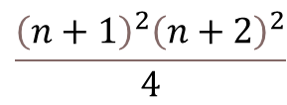
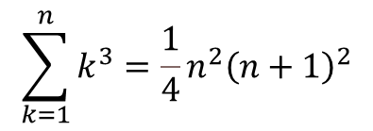
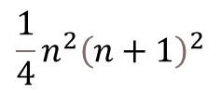

Question 4 :
$${\left.\frac{1}{4} ( n+1\right)}^{2}{\left(n+1+1\right)}^{2}=$$
Step 3 – Induction Step: 𝑛 - > 𝑛 + 1
RHS:
$$\frac{{{\left(n+1\right)}^{2}\left(n+2\right)}^{2}}{4}$$
$$\sum_{k=1}^{n}{k^{3}={\frac{1}{4}n}^{2}{\left(n+1\right)}^{2}}$$
LHS:
$$\frac{{(n}^{2}+2n+1)(n^{2}+4n+4)}{4}$$
$$\sum_{k=1}^{n+1}{k^{3}=}$$
$$\sum_{k=1}^{n}{k^{3}+ {\left(n+1\right)}^{3}}$$
$$=$$
$$\frac{n^{4}+4n^{3}+{4n}^{2}+{2n}^{3}+8n^{2}+8n+n^{2}+4n+4}{4}=$$
Step 1 – Base Case: n=1
$$= {\frac{1}{4}n}^{2}{\left(n+1\right)}^{2}+{\left(n+1\right)}^{3}$$
LHS:
$$\frac{n^{4}+6n^{3}+{13n}^{2}+12n+4}{4}$$
$$1^{3}=1$$
$${=\frac{\left.n^{2} ( n+1\right)}{4}}^{2}+{\left(n+1\right)}^{3}$$
RHS:
$${\frac{1}{4}n}^{2}{\left(n+1\right)}^{2}$$
$$={\frac{1}{4}1}^{2}+{\left(1+1\right)}^{2}=$$
$$=\frac{n^{2}\left(n^{2}+2n+1\right)}{4}+\frac{4{\left(n+1\right)}^{3}}{4}$$
$$\frac{1}{4}2^{2}=\frac{1}{4}\left(4\right)=1$$
$$\frac{n^{4}+{2n}^{3}+n^{2}+4(n^{2}+2n+1)(n+1)}{4}$$
True for $n$=1
$$=$$
$$=$$
$$\frac{n^{4}+{2n}^{3}+n^{2}+4(n^{3}+{2n}^{2}+n+n^{2}+2n+1)}{4}$$
Step 2 – Assumption:
We assume that the claim is true for $n$ as the claim was true for $n$ = 1
$$\frac{n^{4}+{2n}^{3}+n^{2}+{4n}^{3}+{8n}^{2}+4n+{4n}^{2}+8n+4}{4}$$
$$=$$
$$\frac{n^{4}+{6n}^{3}+{13n}^{2}+12n+4}{4}$$
$$\sum_{k=1}^{n}{k^{3}={\frac{1}{4}n}^{2}{\left(n+1\right)}^{2}}$$
$$=$$
LHS is equivalent RHS
By proof of induction the claim is true for all n q.e.d.

