Slide 1
Workshop 4: Shader Black Magic

Slide 2
Aim of this workshop
Create an interesting looking shader
Understand what a shader graph can do
Understand vertex manipulation

Slide 3
Disclaimer
These are personal tips
There are lots of different approaching to this
Always tweak it to what you want

Slide 4
What are Shaders

Slide 5
Basic Understanding
“They perform calculations that determine the colour of pixels on the screen.” - Unity
TLDR: a base blueprint for a material

Slide 6
Shader in Unity
Can be coded in
Using Shader Graph
Node base programming

Slide 7
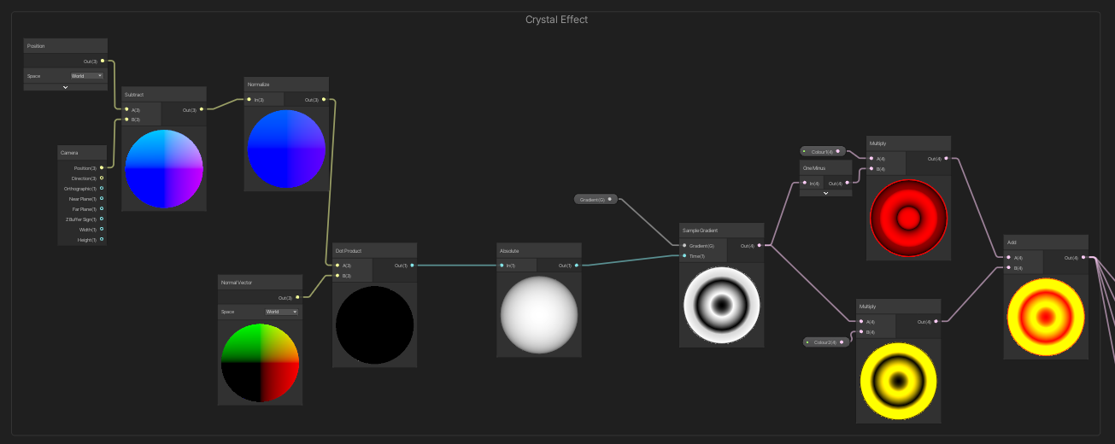
Shader Graphs

Slide 8
Our Shader

Slide 9
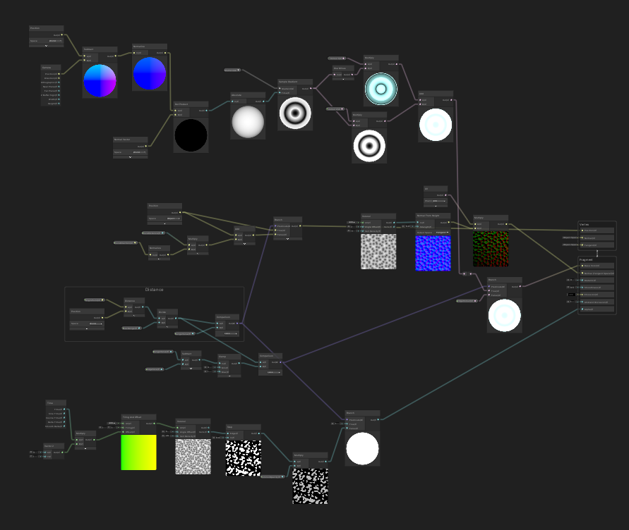
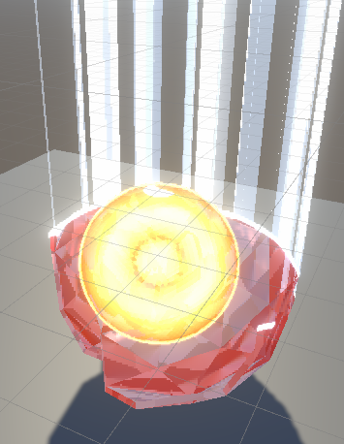

Slide 10
5 Major Components
Crystal Material
Normals
Distance based alpha manipulation
Distance based vertex displacement
Edge glow

Slide 11
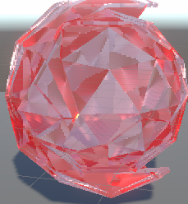
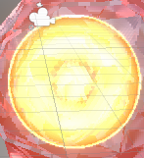
Crystal Material
Dot Product between the direction the camera is facing against the normal vector
Sample a grayscale gradient with that value
Multiply each set with a colour and combine them

Slide 12
Normals
Generate normal from Voronoi
Feed to normal from height
Multiply UV

Slide 13
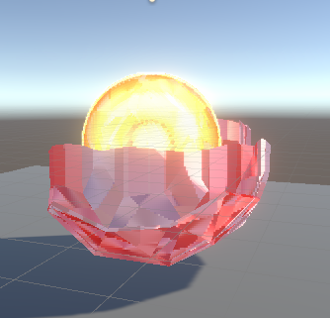
Distance based alpha manipulation
Different behavior depending on the distance of each vertex to the original point
Each vertex is a fraction of the distance
A control range between 0-1
If the fraction below the control value, alpha is 1, if it is greater then 0

Slide 14
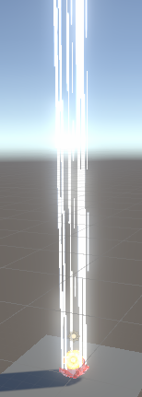
Distance based vertex displacement
Set vertex position for vertex above the control value will increase the vertex to a max distance
Also need to set the direction it moves
To make it look like pieces are falling down, change the alpha from 1 to take a Voronoi cell

Slide 15
Edge glow
Have a little offset from the control value which is the edge width
If the fraction distance is within the control value and offset
Then change colour

Slide 16
Coding a controller
A script that controls the material
Animator to control the values
Eg the phase in effect

Slide 17
Line Connecting/ Coding Time

