Slide 1
Workshop 3: Less Dumb Enemy AI

Slide 2
Aim of this workshop
Patrol paths
Line of sight and vision cone
Incorporate Animations

Slide 3
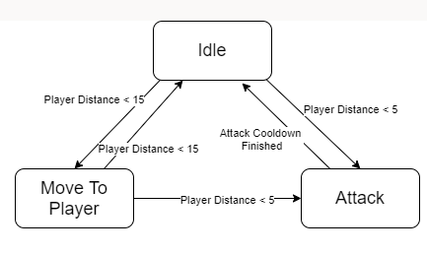
Recap
Last time:
Initial setup of Enemy
Detect distance to player
Move to player using nav mesh

Slide 4
Improvements
Bug fix attack
Patrol around certain points and wait
Only chase the player if it has line of sight
Angle limit/ vision cone on line of sight
Attack animation

Slide 5
Bug fix

Slide 6
Patrol

Slide 7
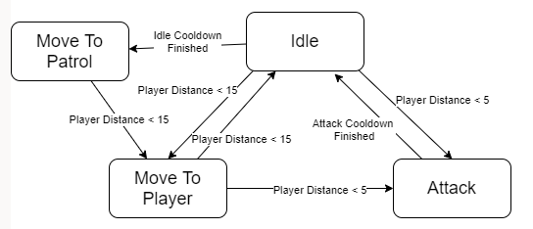
Idea
Patrol Manager
Stores points to patrol to
Can request a specific point with a given index
Enemy AI
Request and move to a patrol point
Wait at that location for X seconds
Repeat

Slide 8
Line of Sight

Slide 9
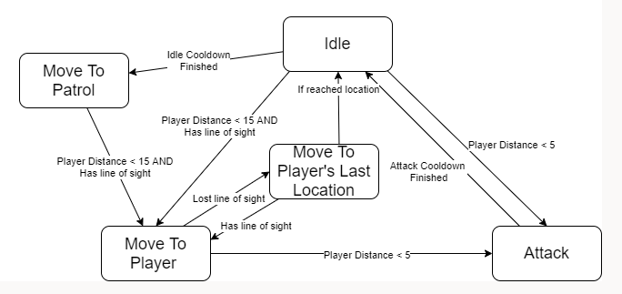
Idea
Raycast in the direction from enemy to player
Separate enviorment and player layer
Move to player’s last known location and wait if lost

Slide 10
Raycast
Layer Masks:
Player
Player
Enemy

Slide 11
Raycast
Layer Masks:
Player
Wall
Wall
Player
Enemy

Slide 12
Raycast
Layer Masks:
Player
Wall
Player
Enemy

Slide 13
Vision Cone

Slide 14
Approaches
Using a cones shaped trigger mesh
OnTriggerEnter, then spotted, etc
Dot product the AI’s “head” forward direction to direction to player

Slide 15
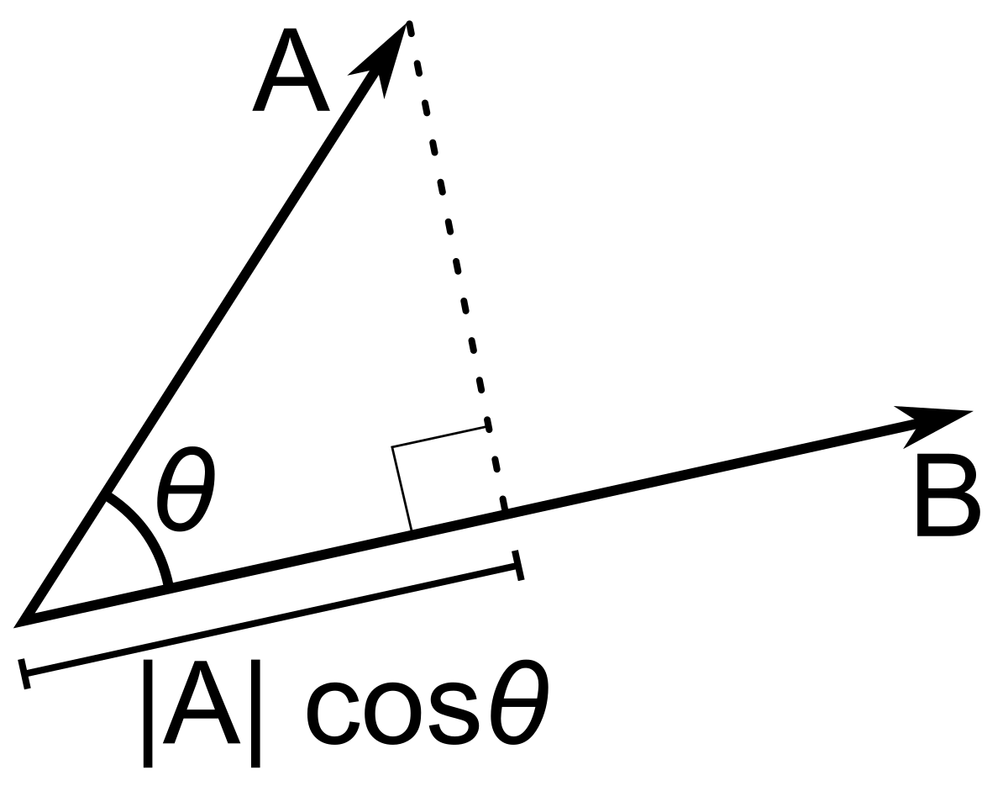
Dot Product
Yay maths
Takes 2 directional vector
Results:
1: same direction
0: 90 degrees
-1: opposite
Acos(Results) to get the angle

Slide 16
Idea
Dot product the AI’s “head” forward direction to direction to player
Set a minimum value as the angle of the cone
Returns true if Dot product is larger than that value
45 Deg.
= 0.7

Slide 17
Attack Animation

Slide 18
Idea
The attacking duration depends on animation
Move the End attack methods to be called in animation
Start attack triggers an animation
Add a simple attack animation

