Slide 1
Workshop 2: Enemy AI

Slide 2
Aim of this workshop
Understand the basic theory of what a basic AI will involve
Designing and creating a flow chart/ FNS for the AI
Approaches to coding the AI
General tips
Coding the AI in

Slide 3
Disclaimer
These are personal tips
There are lots of different approaching to this
Always tweak it to what you want

Slide 4
Theory

Slide 5
Why AI?
Player overcoming some challenge(s) involving an entity
The entity requires some form of logic and intelligence
Including just attacking the player in range
Can expand to be more interesting

Slide 6
High Level
Think
Act

Slide 7
Our AI
It will do:
Think
Act
Idle
Move
Attack

Slide 8
AI’s Think
Takes all the data that it needs
Current state of the AI
Distance to the player
Cooldown timers (attack cooldown)

Slide 9
Idle
Sit and wait
A delay/ gap before it thinks and make a decision again

Slide 10
Move
Reposition to a new location
A patrol point
Player’s position
Using Navmesh probably

Slide 11
Attack
A way of interaction with the player
Dealing damage with the player
Melee attack
Box or sphere cast
Range attack
Raycast or firing a projectile

Slide 12
Designing

Slide 13
What It Will Do
It walks and stand around at patrol points
If the player is within a certain range, it will walk towards the player
If the player is within the attack range, it will attack

Slide 14
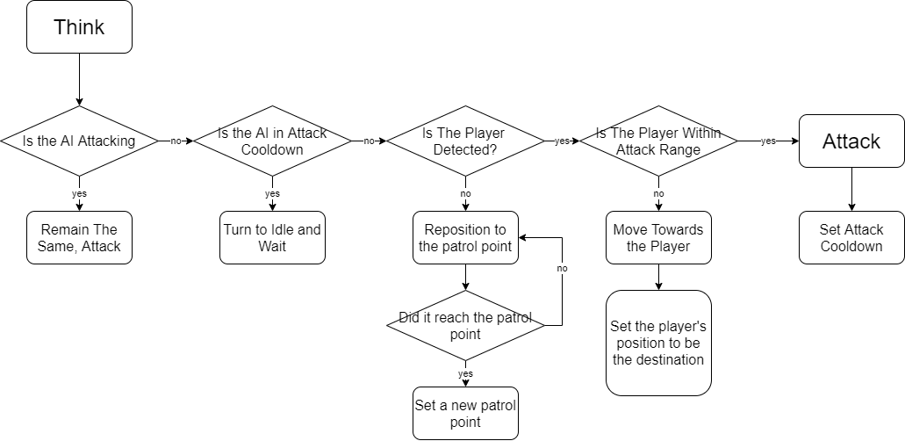
Flow Chart

Slide 15
Approaches

Slide 16
Many Ways…
Lots of nested if statements with Boolean flags
Good starting place, but a nightmare to manage and debug
FSM
Set what state the AI is in and acts according to that state
Using an Enum to record what state the AI is in
Using the Animator in Unity
Like in Brackey’s “How to make a BOSS in Unity!”
https://www.youtube.com/watch?v=AD4JIXQDw0s&ab_channel=Brackeys
Many other approaches

Slide 17
Our Approach
State Enum Approach
Logging and changing the state of the AI
Regularly check if the AI is following the flow chart
Know what it should be doing
Easier to debug and improve individual components

Slide 18
General Tips

Slide 19
Tips
Developing the AI is an ongoing process
Flowchart will change non stop
Sometimes modifications will work
Expect to refactor the code regularly

Slide 20
Code Time

Slide 21
Set Up Player
Set up the Enemy Game Object
State Handling
AIThink and AIBehaviour
Think Rate
Range Detections
Movement with NavMesh
(Faking) Attacking the Player
Patrol Movement/ Manager
Line of Sight

