Slide 1
Workshop 1: Input System and Controls

Slide 2
Aim
By the end of the workshop, you will:
Understand the “new” Input System
Basic theory in coding movement
Coding in a basic First Person movement in unity

Slide 3
Disclaimer
These are personal tips
There are lots of different approaching to this

Slide 4
Input System

Slide 5
Benefits of the Input System
*Input Manager is the old system
Can define specific Actions
Movement
Interacting
Allows multiple keybinds to the same Action
Allows a lot more different types of keybinds
Can have different actions maps
On foot
Driving
Different mappings for different control inputs

Slide 6
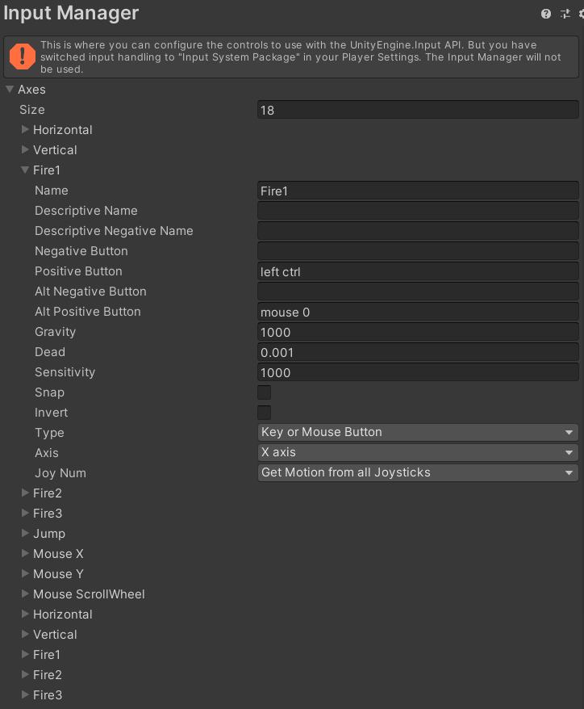

Slide 7
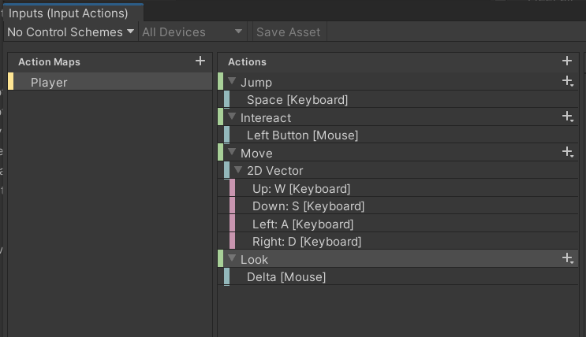

Slide 8
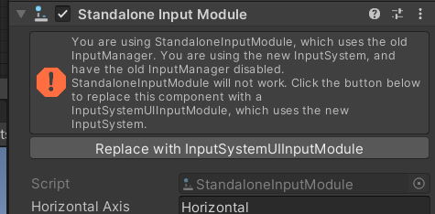
Drawbacks
Getting a specific key downs would be more complicated
GetKeyDown WILL NOT WORK
Requires some set ups
Changing the project settings
Changing the event manager

Slide 9
Controls

Slide 10
2 Types of Movement
Transform
Physics
Moving the player object for X Units
Character Controller
Include Collider
Stairs and Slope Handling
NO GRAVITY
Funny interactions when colliding with physics objects
Applies forces to the player
Rigid Body
Apply and Receive Forces
Has Gravity
Only use if the physics is a core focus of the game
How to Move Characters In Unity 3D | Character Controllers Explained
https://www.youtube.com/watch?v=e94KggaEAr4&ab_channel=iHeartGameDev

Slide 11
General Inputs
Inputs for general Character Moving games
Moving in a direction
Looking
Jumping
Mouse/ Button Input

Slide 12
How it works in code
Taking the player inputs and storing the values
Update the character in game based on the values
Typically in the Update() method
FixedUpdate() for physics based

Slide 13
Movement
Takes a 2 axis input
Setting the “Player’s move direction”
Update the character based on that
Either by transform or physics

Slide 14
Looking
Take 2 axis input
X axis rotate left and right
Y axis rotate up and down

Slide 15
Jumping (And Gravity)
Applying some upward force on button press
Physics
AddForce going upwards
Very simple
Transform
Update and store variable for upwards velocity or acceleration
Update the character’s position
Simulating gravity

Slide 16
Ground Check
To check if the player is touching the ground
Many different approaches
Colliding with “the ground”
Ray casting downwards
Sphere checking on their feet

Slide 17
Button Input
Interacting
Ray casting in a direction
Ability use
Press X to do Y

Slide 18
Setting Up in Unity

Slide 19
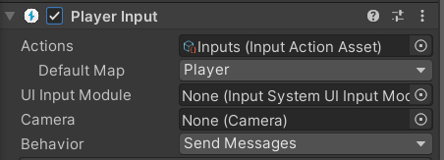
Different Ways
Most ways involves the “Player Input” Component
Taking inputs based off the action maps
Converting Inputs to method calls

Slide 20
Send Message
Calls the method for the corresponding action
Example
If a key for Action A is pressed
Method with the name “On<name of Action A>” will be called
Method with the matching name activates on the same object

Slide 21
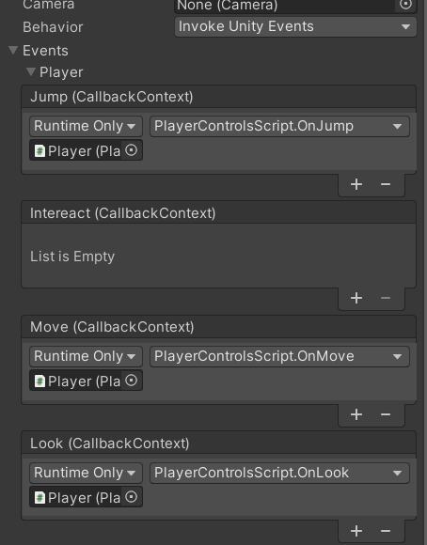
Unity Events
Executing a Unity Events when an action happens
Different syntax
More flexibility, but more “Messy”

Slide 22
Coding Time

Slide 23
Starter Assets

Slide 24
Starter Assets
New official unity assets for first and third person controllers
Great for starting off or prototyping
Possible to modify the code
Uses the input system and cinemachine
Links:
https://assetstore.unity.com/packages/essentials/starter-assets-first-person-character-controller-196525
https://assetstore.unity.com/packages/essentials/starter-assets-third-person-character-controller-196526
Guides:
https://www.youtube.com/watch?v=4QuPlKzdq14&ab_channel=Unity
https://www.youtube.com/watch?v=jXz5b_9z0Bc&t=87s&ab_channel=CodeMonkey

