Slide 1
Calculus

Slide 2
Differentiation and Linear Function
$$y=mx+b$$
$$gradient=\frac{rise}{run}$$
$$gradient=\frac{y_{2}−y_{1}}{x_{2}−x_{1}}$$
$$A(−3,0)$$
$$B(0,3)$$
$$gradient=\frac{3−0}{0−−3}=\frac{3}{3}=1$$
$$y=x+b$$
$$y=x+3$$

Slide 3
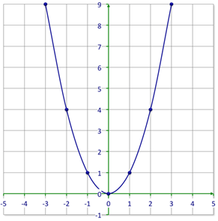
Parabola
$$y=x^{2}$$

Slide 4
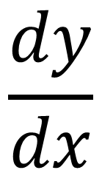
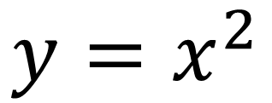
Gradient Function
$$y=x^{2}$$
$$\frac{dy}{dx}$$
$$=\frac{diffrentiate y}{with respect to x}$$
$$f(x)=x^{2}$$
$$f^{′}\left(x\right)=first derivative$$

Slide 5
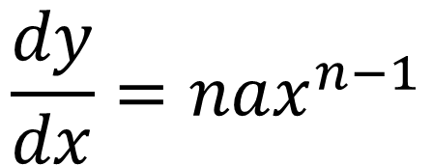
Polynomials
$$y=2x+2$$
$$y={ax}^{n}$$
$$\frac{dy}{dx}=2x^{1−1}=2$$
$$\frac{dy}{dx}=nax^{n−1}$$
Find Second derivative:
$$f\left(x\right)=x^{2}$$
$$y=x^{2}$$
$$f′\left(x\right)=2x$$
$$\frac{dy}{dx}=2x^{2−1}={2x}^{1}=2x$$
$$f^{′′}\left(x\right)=2x^{1−1}=2$$

Slide 6
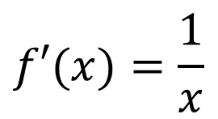
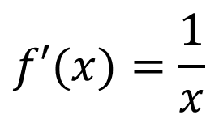
Rules
$$f(x)={ax}^{n}$$
$$f′(x)={nax}^{n−1}$$
$$f(x)=sin⁡(x)$$
$$f′(x)=cos⁡(x)$$
$$f(x)=cos⁡(x)$$
$$f^{′}\left(x\right)=−sin⁡(x)$$
$$f(x)=e^{x}$$
$$f′(x)=e^{x}$$
$$f′(x)=\frac{1}{x}$$
$$f(x)=log⁡(x)$$
$$f′(x)=\frac{1}{x}$$
$$f(x)=ln⁡(x)$$

Slide 7
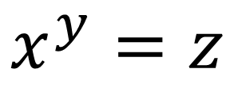
Logarithms
$$x^{y}=z$$
$$\log_{x}{z=y}$$
$$3^{x}=27$$
$$\log_{3}{27}$$
$$=3$$
$$2^{x}=17$$
$$\log_{2}{17}$$
$$=4.087463…$$

Slide 8
Question
$$y={6x}^{3}−9x+4$$
$$y=\frac{4}{x^{2}}+5x$$
$$\frac{dy}{dx}=3×6x^{3−1}−9x^{1−1}$$
$$y={4x}^{−2}+5x$$
$$\frac{dy}{dx}=18x^{2}−9$$
$$\frac{dy}{dx}=−2×{4x}^{−2−1}+5$$
$$\frac{dy}{dx}=−8x^{−3}+5$$
$$y={4x}^{−7}−4x+4$$
$$\frac{dy}{dx}=−7×{4x}^{−7−1}−4$$
$$\frac{dy}{dx}=−\frac{1}{{8x}^{3}}+5$$
$$\frac{dy}{dx}={−28x}^{−8}−4$$

Slide 9
Question
$$y=\cos\left(x\right)sin⁡(x)$$
$$y=e^{x}$$
$$\frac{dy}{dx}=−\sin\left(x\right)$$
$$\frac{dy}{dx}=e^{x}$$
$$cos⁡(x)$$
$$y=\sin\left(x\right)sin⁡(x)$$
$$y=log(5x)$$
$$\frac{dy}{dx}=cos⁡(x)$$
$$cos⁡(x)$$
$$\frac{dy}{dx}=\frac{1}{5x}$$
$$Find second derivative$$
$$f(x)=\sin\left(x\right)cos⁡(x)$$
$$y=ln(5x)$$
$$f′(x)=−cos\left(x\right)sin⁡(x)$$
$$\frac{dy}{dx}=\frac{1}{5x}$$
$$f′′(x)=\sin\left(x\right)cos⁡(x)$$

Slide 10
Product Rule
$$h\left(x\right)=f(x)×g(x)$$
$$h^{′}\left(x\right)=f′\left(x\right)g(x)+f(x)g′(x)$$
$$h\left(x\right)=x^{3}{(x+1)}^{2}$$
$$h^{′}\left(x\right)={3x}^{2}{\left(x+1\right)}^{2}$$
$$+{2x}^{3}(x+1)$$
$${3x}^{2}\left(x^{2}+2x+1\right)+{2x}^{3}(x+1)$$
$${3x}^{4}+{6x}^{3}+{3x}^{2}+{2x}^{4}+{2x}^{3}$$
$${5x}^{4}+{8x}^{3}+{3x}^{2}$$

Slide 11
Chain Rule
$$h\left(x\right)=f(g(x))$$
$$h′\left(x\right)=f′(g(x))×g′(x)$$
$$h\left(x\right)={({2x}^{2}+4)}^{7}$$
$$h′\left(x\right)={7({2x}^{2}+4)}^{6}×4x$$
$$h′\left(x\right)={28x({2x}^{2}+4)}^{6}$$

Slide 12
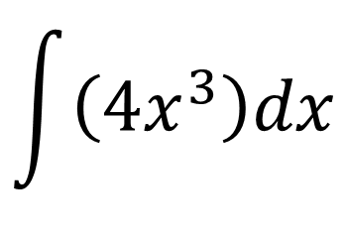

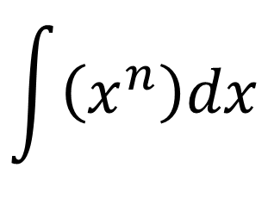

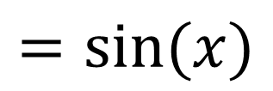

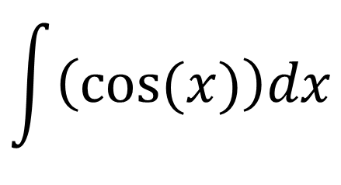
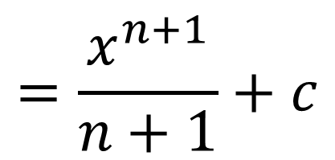
Integration
INTEGRATION IS THE REVERSE PROCESS OF DIFFERENTIATION
$$\int{\left(x^{n}\right)dx}$$
$$=\frac{x^{n+1}}{n+1}+c$$
$$\int{\left({4x}^{3}\right)dx}$$
$$=\frac{{4x}^{3+1}}{3+1}$$
$$=\frac{{4x}^{4}}{4}$$
$$+c$$
$$=x^{4}$$
$$\int{\left(cos⁡(x)\right)dx}$$
$$=sin⁡(x)$$

Slide 13
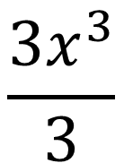
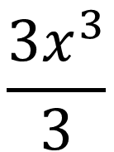
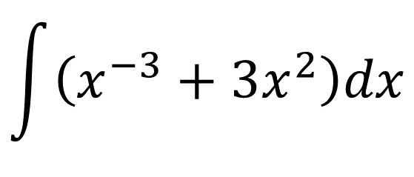
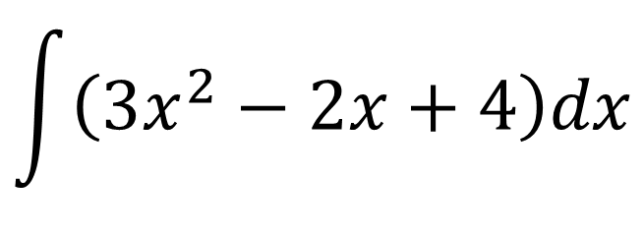
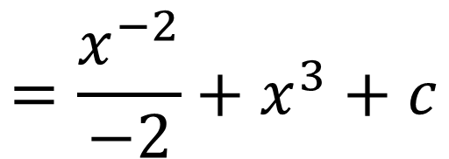
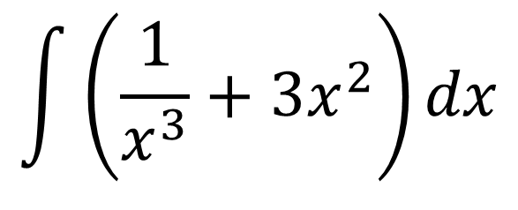
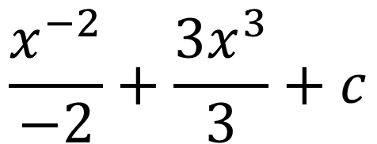
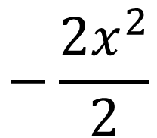
Question
$$a^{−m}=\frac{1}{a^{m}}$$
$$\int{\left({3x}^{2}−2x+4\right)dx}$$
$$\int{\left(\frac{1}{x^{3}}+{3x}^{2}\right)dx}$$
$$\frac{{3x}^{3}}{3}$$
$$−\frac{{2x}^{2}}{2}$$
$$\int{\left(x^{−3}+{3x}^{2}\right)dx}$$
$$+4x$$
$$+c$$
$$\frac{{3x}^{3}}{3}$$
$$\frac{x^{−3+1}}{−3+1}+\frac{{3x}^{2+1}}{2+1}+c$$
$$−x^{2}$$
$$+4x$$
$$+c$$
$$\frac{x^{−2}}{−2}+\frac{{3x}^{3}}{3}+c$$
$$=\frac{x^{−2}}{−2}+x^{3}+c$$

Slide 14
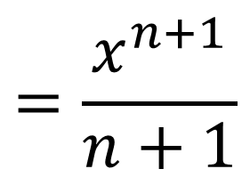
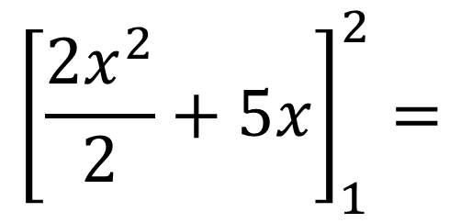
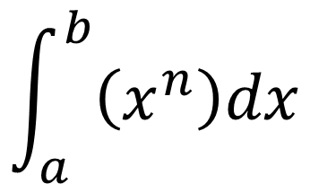
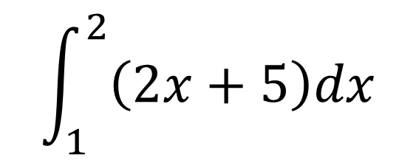
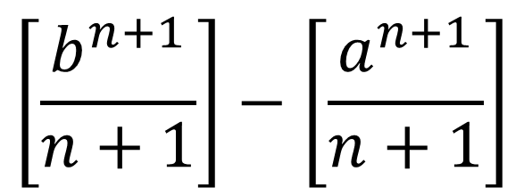
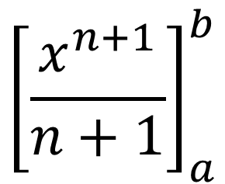
Definite Integral
$$\int_{1}^{2}{\left(2x+5\right)dx}$$
$$\int_{a}^{b}{\left(x^{n}\right)dx}$$
$$=\frac{x^{n+1}}{n+1}$$
$${\left[\frac{{2x}^{2}}{2}+5x\right]}_{1}^{2}=$$
$${\left[\frac{x^{n+1}}{n+1}\right]}_{a}^{b}$$
$${\left[x^{2}+5x\right]}_{1}^{2}$$
$$\left[2^{2}+(5×2)\right]−\left[1^{2}+(5×1)\right]$$
$$\left[\frac{b^{n+1}}{n+1}\right]−\left[\frac{a^{n+1}}{n+1}\right]$$
$$\left[4+10\right]−\left[1+5\right]$$
$$14−6=8$$

Slide 15
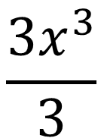
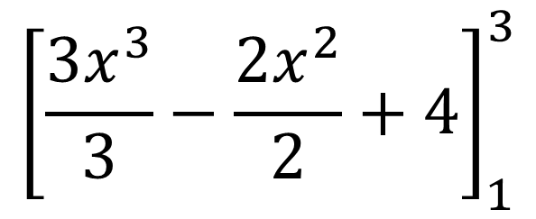
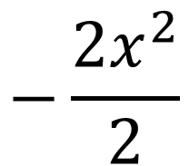
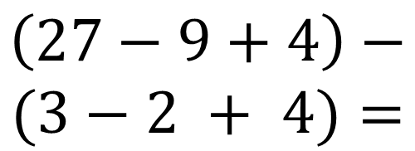
Question
$${\left[\frac{{3(3)}^{3}}{3}−\frac{{2(3)}^{2}}{2}+4\right]}_{1}^{3}−$$
$$\int_{1}^{3}{\left({3x}^{2}−2x+4\right)dx}$$
$$\frac{{3x}^{3}}{3}$$
$$−\frac{{2x}^{2}}{2}$$
$${\left[\frac{{3(1)}^{3}}{3}−\frac{{2(1)}^{2}}{2}+4\right]}_{1}^{3}=$$
$$+4x$$
$${\left[\frac{{3x}^{3}}{3}−\frac{{2x}^{2}}{2}+4\right]}_{1}^{3}$$
$$\left(27−9+4\right)−$$
$$(3−2 + 4)=$$
$$22+5=27$$

Slide 16
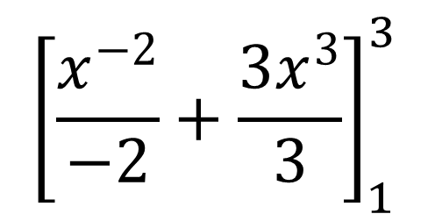
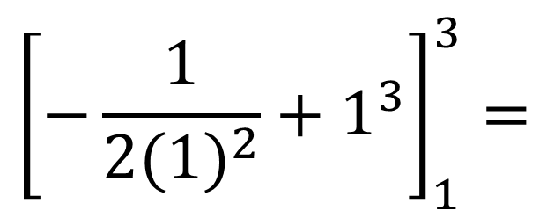
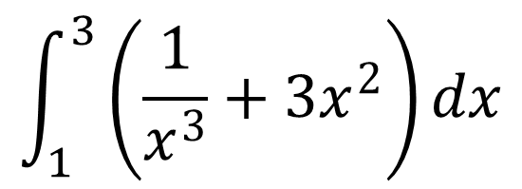
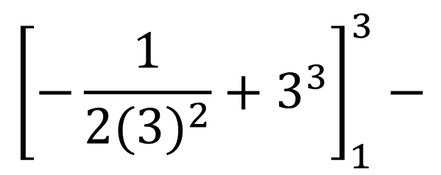
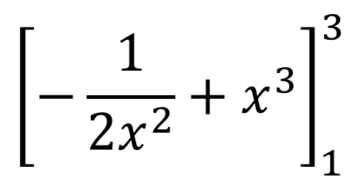
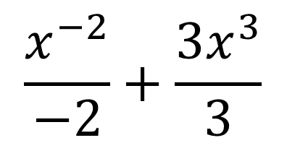
Question
$$\int_{1}^{3}{\left(\frac{1}{x^{3}}+{3x}^{2}\right)dx}$$
$${\left[−\frac{1}{{2(3)}^{2}}+3^{3}\right]}_{1}^{3}−$$
$$\frac{x^{−2}}{−2}+\frac{{3x}^{3}}{3}$$
$${\left[−\frac{1}{{2(1)}^{2}}+1^{3}\right]}_{1}^{3}=$$
$${\left[\frac{x^{−2}}{−2}+\frac{{3x}^{3}}{3}\right]}_{1}^{3}$$
$$\left(−\frac{1}{18}+27\right)−\left(−\frac{1}{2}+1\right)$$
$${\left[−\frac{1}{{2x}^{2}}+x^{3}\right]}_{1}^{3}$$
$$\frac{485}{18}−\frac{1}{2}=\frac{485−9}{18}=\frac{476}{18}=26\frac{4}{9}$$

Slide 17

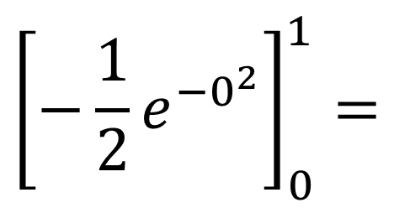
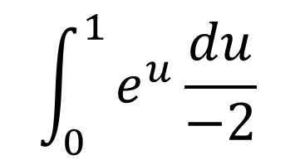
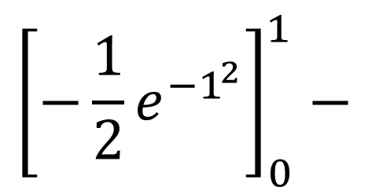

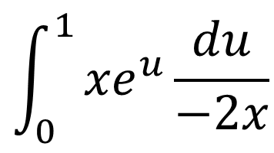
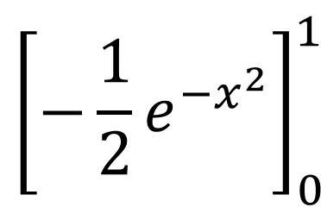
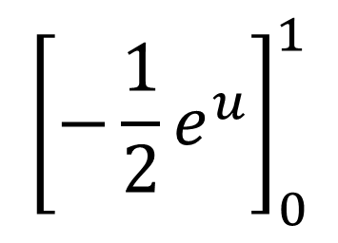

Extra Question
$$u={−x}^{2}$$
$$\frac{du}{dx}=−2x$$
$$−\frac{1}{2} \int_{0}^{1}{{(e}^{u})du}$$
$$dx=\frac{du}{−2x}$$
$$\int_{0}^{1}{\left({xe}^{{−x}^{2}}\right)dx}$$
$${\left[−\frac{1}{2}e^{{−1}^{2}}\right]}_{0}^{1}−$$
$${\left[−\frac{1}{2}e^{u}\right]}_{0}^{1}$$
$$\int_{0}^{1}{{xe}^{u}\frac{du}{−2x}}$$
$$\int_{0}^{1}{e^{u}\frac{du}{−2}}$$
$${\left[−\frac{1}{2}e^{{−0}^{2}}\right]}_{0}^{1}=$$
$${\left[−\frac{1}{2}e^{{−x}^{2}}\right]}_{0}^{1}$$
$$\int_{0}^{1}{{(−\frac{1}{2}e}^{u})du}$$
$$−\frac{1}{2e}−\frac{1}{2}=−\frac{1+e}{2e}$$

