Slide 1
Inverse of a Matrix

Slide 2
Steps
Step 1: Find the determinant
Step 2: Find the Matrix of Cofactors
Step 3: Find the Transpose of Cofactor matrix
Step 4: Multiply Transpose matrix by 1/Determinant.

Slide 3
Formula
$$A^{−1}=\frac{1}{\det\left(A\right)}{(cof(A))}^{T}$$

Slide 4
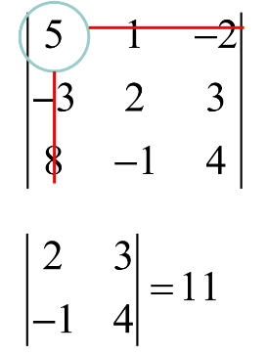
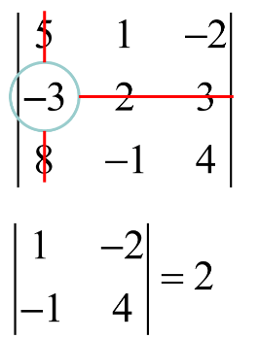
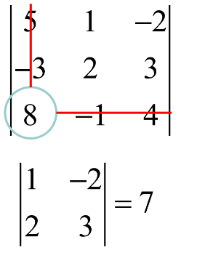
Identifying Minor Matrix

Slide 5
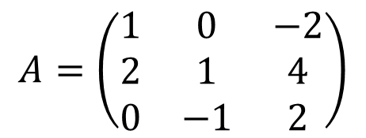
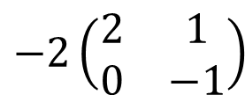
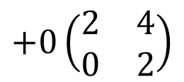
Question 1: Step 1: Matrix determinant
$$A=\left(\begin{matrix}1 & 0 & −2 \\ 2 & 1 & 4 \\ 0 & −1 & 2\end{matrix}\right)$$
$$\det\left(M\right)=\left(\begin{matrix}a & c \\ b & d\end{matrix}\right)=\left(a×d\right)−(c×b)$$
$$\det\left(A\right)=1\left(\begin{matrix}1 & 4 \\ −1 & 2\end{matrix}\right)$$
$$+0\left(\begin{matrix}2 & 4 \\ 0 & 2\end{matrix}\right)$$
$$−2\left(\begin{matrix}2 & 1 \\ 0 & −1\end{matrix}\right)$$
$$1\left[\left(1×2\right)−\left(4×−1\right)\right]$$
$$+ 0\left[\left(2×2\right)−(4×0)\right]$$
$$−2\left[\left(2×−1\right)−(1×0)\right]$$
$$1\left(2+4\right)+0\left(4−0\right)−2(−2−0)$$
$$6+0+4=10$$

Slide 6
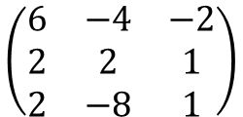
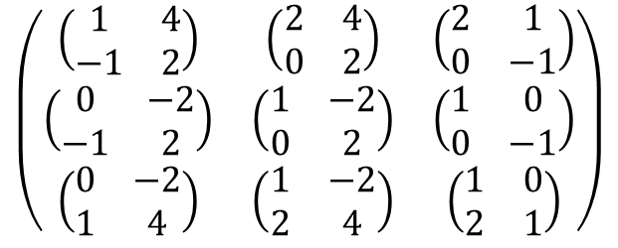
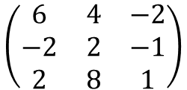
Step 2: Find Cofactor Matrix
$$A=\left(\begin{matrix}1 & 0 & −2 \\ 2 & 1 & 4 \\ 0 & −1 & 2\end{matrix}\right)$$
$$\left(\begin{matrix}\left(\begin{matrix}1 & 4 \\ −1 & 2\end{matrix}\right) & \left(\begin{matrix}2 & 4 \\ 0 & 2\end{matrix}\right) & \left(\begin{matrix}2 & 1 \\ 0 & −1\end{matrix}\right) \\ \left(\begin{matrix}0 & −2 \\ −1 & 2\end{matrix}\right) & \left(\begin{matrix}1 & −2 \\ 0 & 2\end{matrix}\right) & \left(\begin{matrix}1 & 0 \\ 0 & −1\end{matrix}\right) \\ \left(\begin{matrix}0 & −2 \\ 1 & 4\end{matrix}\right) & \left(\begin{matrix}1 & −2 \\ 2 & 4\end{matrix}\right) & \left(\begin{matrix}1 & 0 \\ 2 & 1\end{matrix}\right)\end{matrix}\right)$$
$$\left(\begin{matrix}\left(1×2\right)−(4×−1) & \left(2×2\right)−(4×0) & \left(2×−1\right)−(1×0) \\ \left(0×2\right)−(−2×−1) & \left(1×2\right)−(−2×0) & \left(1×−1\right)−(0×0) \\ \left(0×4\right)−(−2×1) & \left(1×4\right)−(−2×2) & \left(1×1\right)−(0×2)\end{matrix}\right)$$
$$\left(\begin{matrix}2+4 & 4−0 & −2−0 \\ 0−2 & 2−0 & −1−0 \\ 0+2 & 4+4 & 1−0\end{matrix}\right)$$
$$\left(\begin{matrix}6 & −4 & −2 \\ 2 & 2 & 1 \\ 2 & −8 & 1\end{matrix}\right)$$
$$\left(\begin{matrix}6 & 4 & −2 \\ −2 & 2 & −1 \\ 2 & 8 & 1\end{matrix}\right)$$

Slide 7
Step 3: Transpose of cofactor matrix
$$Cof(A)\left(\begin{matrix}6 & −4 & −2 \\ 2 & 2 & 1 \\ 2 & −8 & 1\end{matrix}\right)$$
$${Cof(A)}^{T}\left(\begin{matrix}6 & 2 & 2 \\ −4 & 2 & −8 \\ −2 & 1 & 1\end{matrix}\right)$$

Slide 8
Step 4: Multiply Transpose matrix by 1/Determinant
$$Det\left(A\right)=10$$
$${Cof(A)}^{T}\left(\begin{matrix}6 & 2 & 2 \\ −4 & 2 & −8 \\ −2 & 1 & 1\end{matrix}\right)$$
$$A^{−1}=\frac{1}{10}\left(\begin{matrix}6 & 2 & 2 \\ −4 & 2 & −8 \\ −2 & 1 & 1\end{matrix}\right)$$

Slide 9
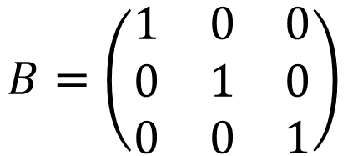
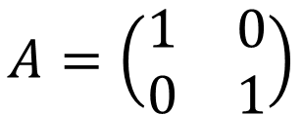
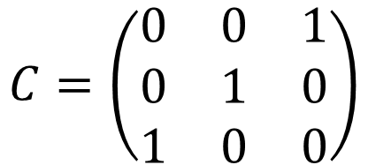
Question
$$A=\left(\begin{matrix}1 & 0 \\ 0 & 1\end{matrix}\right)$$
$$B=\left(\begin{matrix}1 & 0 & 0 \\ 0 & 1 & 0 \\ 0 & 0 & 1\end{matrix}\right)$$
$$C=\left(\begin{matrix}0 & 0 & 1 \\ 0 & 1 & 0 \\ 1 & 0 & 0\end{matrix}\right)$$
IT IS JUST 3x3 MATRIX (NOT IDENTITY)

Slide 10
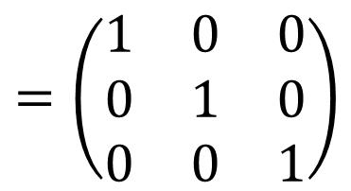
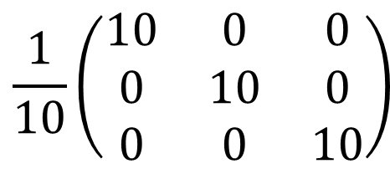
Was my inverse of a matrix correct?
$$A^{−1}A=I$$
$\frac{1}{10}\left(\begin{matrix}6 & 2 & 2 \\ −4 & 2 & −8 \\ −2 & 1 & 1\end{matrix}\right)$ $\left(\begin{matrix}1 & 0 & −2 \\ 2 & 1 & 4 \\ 0 & −1 & 2\end{matrix}\right)$
$$\frac{1}{10}\left(\begin{matrix}6+4+0 & 0+2−2 & −12+8+4 \\ −4+4+0 & 0+2+8 & 8+8−16 \\ −2+2+0 & 0+1−1 & 4+4+2\end{matrix}\right)$$
$$\frac{1}{10}\left(\begin{matrix}10 & 0 & 0 \\ 0 & 10 & 0 \\ 0 & 0 & 10\end{matrix}\right)$$
$$=\left(\begin{matrix}1 & 0 & 0 \\ 0 & 1 & 0 \\ 0 & 0 & 1\end{matrix}\right)$$

Slide 11
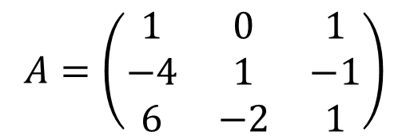
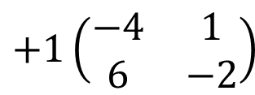
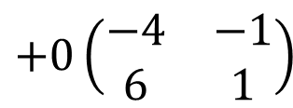
Question 2: Step 1: Matrix determinant
$$A=\left(\begin{matrix}1 & 0 & 1 \\ −4 & 1 & −1 \\ 6 & −2 & 1\end{matrix}\right)$$
$$\det\left(M\right)=\left(\begin{matrix}a & c \\ b & d\end{matrix}\right)=\left(a×d\right)−(c×b)$$
$$\det\left(A\right)=1\left(\begin{matrix}1 & −1 \\ −2 & 1\end{matrix}\right)$$
$$+0\left(\begin{matrix}−4 & −1 \\ 6 & 1\end{matrix}\right)$$
$$+1\left(\begin{matrix}−4 & 1 \\ 6 & −2\end{matrix}\right)$$
$$1\left[\left(1×1\right)−\left(−1×−2\right)\right]$$
$$+ 0\left[\left(−4×1\right)−(−1×6)\right]$$
$$+1\left[\left(−4×−2\right)−(1×6)\right]$$
$$1\left(1−2\right)+0\left(−4+6\right)+1(8−6)$$
$$−1+0+2=1$$

Slide 12
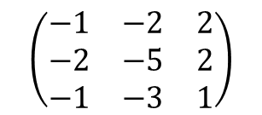
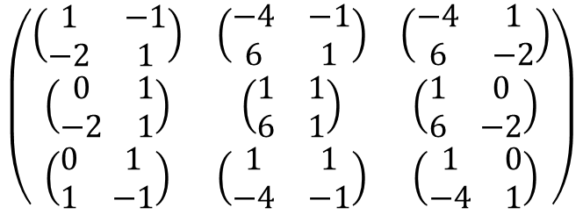
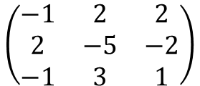
Step 2: Find Cofactor Matrix
$$A=\left(\begin{matrix}1 & 0 & 1 \\ −4 & 1 & −1 \\ 6 & −2 & 1\end{matrix}\right)$$
$$\left(\begin{matrix}\left(\begin{matrix}1 & −1 \\ −2 & 1\end{matrix}\right) & \left(\begin{matrix}−4 & −1 \\ 6 & 1\end{matrix}\right) & \left(\begin{matrix}−4 & 1 \\ 6 & −2\end{matrix}\right) \\ \left(\begin{matrix}0 & 1 \\ −2 & 1\end{matrix}\right) & \left(\begin{matrix}1 & 1 \\ 6 & 1\end{matrix}\right) & \left(\begin{matrix}1 & 0 \\ 6 & −2\end{matrix}\right) \\ \left(\begin{matrix}0 & 1 \\ 1 & −1\end{matrix}\right) & \left(\begin{matrix}1 & 1 \\ −4 & −1\end{matrix}\right) & \left(\begin{matrix}1 & 0 \\ −4 & 1\end{matrix}\right)\end{matrix}\right)$$
$$\left(\begin{matrix}\left(1×1\right)−(−1×−2) & \left(−4×1\right)−(−1×6) & \left(−4×−2\right)−(1×6) \\ \left(0×1\right)−(1×−2) & \left(1×1\right)−(1×6) & \left(1×−2\right)−(0×6) \\ \left(0×−1\right)−(1×1) & \left(1×−1\right)−(1×−4) & \left(1×1\right)−(0×−4)\end{matrix}\right)$$
$$\left(\begin{matrix}1−2 & −4+6 & 8−6 \\ 0+2 & 1−6 & −2−0 \\ 0−1 & −1+4 & 1−0\end{matrix}\right)$$
$$\left(\begin{matrix}−1 & 2 & 2 \\ 2 & −5 & −2 \\ −1 & 3 & 1\end{matrix}\right)$$
$$\left(\begin{matrix}−1 & −2 & 2 \\ −2 & −5 & 2 \\ −1 & −3 & 1\end{matrix}\right)$$

Slide 13
Step 3: Transpose of cofactor matrix
$$Cof(A)\left(\begin{matrix}−1 & −2 & 2 \\ −2 & −5 & 2 \\ −1 & −3 & 1\end{matrix}\right)$$
$${Cof(A)}^{T}=\left(\begin{matrix}−1 & −2 & −1 \\ −2 & −5 & −3 \\ 2 & 2 & 1\end{matrix}\right)$$

Slide 14
Step 4: Multiply Transpose matrix by 1/Determinant
$$Det\left(A\right)=1$$
$${Cof(A)}^{T}\left(\begin{matrix}−1 & −2 & −1 \\ −2 & −5 & −3 \\ 2 & 2 & 1\end{matrix}\right)$$
$$A^{−1}=\frac{1}{1}\left(\begin{matrix}−1 & −2 & −1 \\ −2 & −5 & −3 \\ 2 & 2 & 1\end{matrix}\right)=\left(\begin{matrix}−1 & −2 & −1 \\ −2 & −5 & −3 \\ 2 & 2 & 1\end{matrix}\right)$$

Slide 15
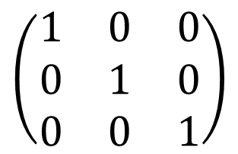
Was my inverse of a matrix correct?
$$A^{−1}A=I$$
$$\left(\begin{matrix}−1 & −2 & −1 \\ −2 & −5 & −3 \\ 2 & 2 & 1\end{matrix}\right)\left(\begin{matrix}1 & 0 & 1 \\ −4 & 1 & −1 \\ 6 & −2 & 1\end{matrix}\right)$$
$$\left(\begin{matrix}−1+8−6 & 0−2+2 & −1+2−1 \\ −2+20−18 & 0−5+6 & −2+5−3 \\ 2−8+6 & 0+2−2 & 2−2+1\end{matrix}\right)$$
$$\left(\begin{matrix}1 & 0 & 0 \\ 0 & 1 & 0 \\ 0 & 0 & 1\end{matrix}\right)$$

Slide 16
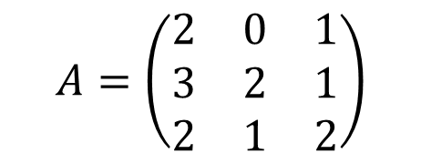
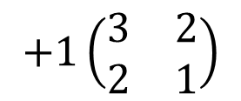
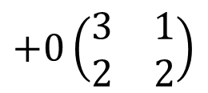
Question 3: Step 1: Matrix determinant
$$A=\left(\begin{matrix}2 & 0 & 1 \\ 3 & 2 & 1 \\ 2 & 1 & 2\end{matrix}\right)$$
$$\det\left(M\right)=\left(\begin{matrix}a & c \\ b & d\end{matrix}\right)=\left(a×d\right)−(c×b)$$
$$\det\left(A\right)=2\left(\begin{matrix}2 & 1 \\ 1 & 2\end{matrix}\right)$$
$$+0\left(\begin{matrix}3 & 1 \\ 2 & 2\end{matrix}\right)$$
$$+1\left(\begin{matrix}3 & 2 \\ 2 & 1\end{matrix}\right)$$
$$2\left[\left(2×2\right)−\left(1×1\right)\right]$$
$$+ 0\left[\left(3×2\right)−(1×2)\right]$$
$$+1\left[\left(3×1\right)−(2×2)\right]$$
$$2\left(4−1\right)+0\left(6−2\right)+1(3−4)$$
$$6+0−1=5$$

Slide 17
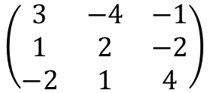
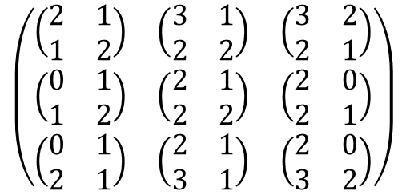
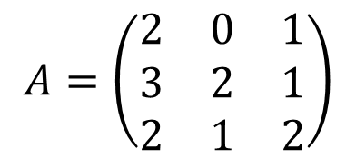
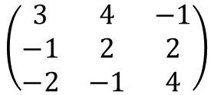
Step 2: Find Cofactor Matrix
$$A=\left(\begin{matrix}2 & 0 & 1 \\ 3 & 2 & 1 \\ 2 & 1 & 2\end{matrix}\right)$$
$$\left(\begin{matrix}\left(\begin{matrix}2 & 1 \\ 1 & 2\end{matrix}\right) & \left(\begin{matrix}3 & 1 \\ 2 & 2\end{matrix}\right) & \left(\begin{matrix}3 & 2 \\ 2 & 1\end{matrix}\right) \\ \left(\begin{matrix}0 & 1 \\ 1 & 2\end{matrix}\right) & \left(\begin{matrix}2 & 1 \\ 2 & 2\end{matrix}\right) & \left(\begin{matrix}2 & 0 \\ 2 & 1\end{matrix}\right) \\ \left(\begin{matrix}0 & 1 \\ 2 & 1\end{matrix}\right) & \left(\begin{matrix}2 & 1 \\ 3 & 1\end{matrix}\right) & \left(\begin{matrix}2 & 0 \\ 3 & 2\end{matrix}\right)\end{matrix}\right)$$
$$\left(\begin{matrix}\left(2×2\right)−(1×1) & \left(3×2\right)−(1×2) & \left(3×1\right)−(2×2) \\ \left(0×2\right)−(1×1) & \left(2×2\right)−(1×2) & \left(2×1\right)−(0×2) \\ \left(0×1\right)−(1×2) & \left(2×1\right)−(1×3) & \left(2×2\right)−(0×3)\end{matrix}\right)$$
$$\left(\begin{matrix}4−1 & 6−2 & 3−4 \\ 0−1 & 4−2 & 2−0 \\ 0−2 & 2−3 & 4−0\end{matrix}\right)$$
$$\left(\begin{matrix}3 & −4 & −1 \\ 1 & 2 & −2 \\ −2 & 1 & 4\end{matrix}\right)$$
$$\left(\begin{matrix}3 & 4 & −1 \\ −1 & 2 & 2 \\ −2 & −1 & 4\end{matrix}\right)$$

Slide 18
Step 3: Transpose of cofactor matrix
$$Cof(A)\left(\begin{matrix}3 & −4 & −1 \\ 1 & 2 & −2 \\ −2 & 1 & 4\end{matrix}\right)$$
$${Cof(A)}^{T}\left(\begin{matrix}3 & 1 & −2 \\ −4 & 2 & 1 \\ −1 & −2 & 4\end{matrix}\right)$$

Slide 19
Step 4: Multiply Transpose matrix by 1/Determinant
$$Det\left(A\right)=5$$
$${Cof(A)}^{T}\left(\begin{matrix}3 & 1 & −2 \\ −4 & 2 & 1 \\ −1 & −2 & 4\end{matrix}\right)$$
$$A^{−1}=\frac{1}{5}\left(\begin{matrix}3 & 1 & −2 \\ −4 & 2 & 1 \\ −1 & −2 & 4\end{matrix}\right)$$

Slide 20
Was my inverse of a matrix correct?
$$A^{−1}A=I$$
$$\frac{1}{5}\left(\begin{matrix}3 & 1 & −2 \\ −4 & 2 & 1 \\ −1 & −2 & 4\end{matrix}\right)\left(\begin{matrix}2 & 0 & 1 \\ 3 & 2 & 1 \\ 2 & 1 & 2\end{matrix}\right)$$
$$\frac{1}{5}\left(\begin{matrix}6+3−4 & 0+2−2 & 3+1−4 \\ −8+6+2 & 0+4+1 & −4+2+2 \\ −2−6+8 & 0−4+4 & −1−2+8\end{matrix}\right)$$
$$\frac{1}{5} \left(\begin{matrix}5 & 0 & 0 \\ 0 & 5 & 0 \\ 0 & 0 & 5\end{matrix}\right)=\left(\begin{matrix}1 & 0 & 0 \\ 0 & 1 & 0 \\ 0 & 0 & 1\end{matrix}\right)$$

