Slide 1
Compilers Workshop

Slide 2
Purpose of workshop
Tell you how to start the coursework
Provide appropriate resources to then complete each of the task

Slide 3
Maximising marks
Compilation – make sure your code compiles with the compilation test provided
Comments – the code will be marked manually so if it structurally makes sense and its easy to understand what's going on you increase your chance of getting a good mark

Slide 4
Setting up the coursework
One directory for each task
Import all the exceptions, interfaces and classes given
The main job is to create a class that implements the given interface
Within that implementation throw exceptions given as appropriate
And then instantiate that interface in the Task class provided
Can use Junit to test your code like in Further Programming

Slide 5
Java Interfaces (1)
Definition
An interface is a template for a class
It tells you the methods a class that implements it must include
interface Lexer {
public List<Token> lex ( String input )
throws LexicalException, Task1Exception; }

Slide 6
Java Interfaces (2)
So now we create a class that implements that interface as follows:
public class MyLexer implements Lexer {
This will have to implement the method:
public ArrayList<Token> lex(String input) throws LexicalException, Task1Exception{…}
NB: ArrayList is an implementation of the Interface List

Slide 7
Java Interfaces (3)
Now in the Task class provided we need to create an instance of the interface implementation:
public static MyLexer create() {
return new MyLexer();
}

Slide 8
Java interfaces (4)
A good quick tutorial on interfaces: https://www.youtube.com/watch?v=kTpp5n_CppQ&t=300s

Slide 9
Lexer
Definition
The Lexer just takes a string of the programming language provided
It converts the string into a list of tokens, where tokens are the ‘atoms’ of the language
In this case when a part of the string corresponds to a token of the language, you want to add the corresponding Token implementation to the token list
If an invalid input is found return an error
Approaches
By-hand (unadvisable)
Jflex (most compact but time consuming to learn and set-up)
Regular expressions (probably the easiest)

Slide 10
Lexer – regular expression approach (1)
import java.util.regex.Matcher;
import java.util.regex.Pattern;
Most of the regular expressions for this language are very simple, for example the regular expression for T_LessEq is just “<=“, and any part of the input string that matches <= is lexed as T_LessEq
Once the expressions are defined it is just a matter of looping through the token list and using the Matcher class to compare the string to each of the expressions

Slide 11
Lexer – regular expression approach (2)
The following tutorial on RegExp in Java gives a basic outline of a solution to this task: https://www.tutorialspoint.com/java/java_regular_expressions.htm
However there are slight differences, i.e. you want to use while(matcher.find()) and some over changes but it will mostly be the same
And if you want to check your regular expressions the following link is useful: https://www.freeformatter.com/java-regex-tester.html
The official Java documentation may be helpful as well: https://docs.oracle.com/javase/7/docs/api/java/util/regex/Pattern.html
https://docs.oracle.com/javase/7/docs/api/java/util/regex/Matcher.html

Slide 12
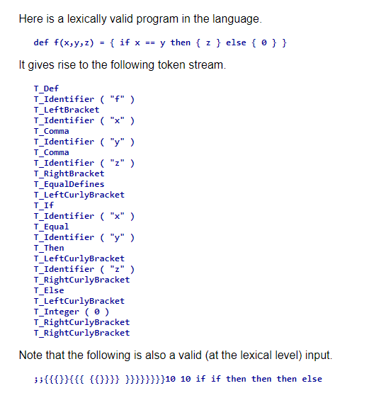
Lexer output

Slide 13
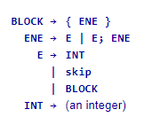
Parser (1)
Definition
Takes the tokens produced by the Lexer and puts them into a ‘parse tree’ which is then traversed to determine if the input is syntactically valid – the in-depth theory is not needed to implement a solution
You need to understand the Context Free Grammar, essentially a set of recursive production rules
For this small CFG we are given
We know from a BLOCK we can produce an { ENE }
We continue performing productions until no non-terminal symbols remain
The non-terminal symbols are those rules that do not form a valid part of the language
If we still have input remining (our token list is not empty) after we have tried all combinations we have an invalid input

Slide 14
Parser (2) – Approaches
Parser generator
Top-down (covered heavily in lecture and very small)

Slide 15
Parser top down code from lecture (1)
In the Parsing part 2 lecture a top-down parser is produced using pseudo-code for the following CFG:
Each production rule roughly requires its own method, hint: the parser is very small so if you have lots of code it’s a sign the approach may be wrong

Slide 16
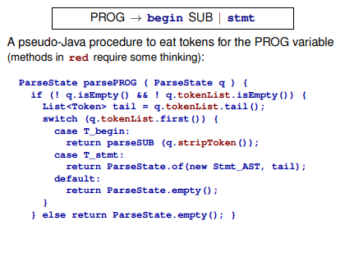
Parser top down code from lecture (2)
From slide 52 of the Parsing part 2 lecture (and the method for the SUB rule is given on slide 55):
Your methods for each rule will be very similar to this
You need to think about how to adapt this to java code
In particular you need to think about the methods the List interface provides so you can ‘eat’ the tokens appropriately
Maybe try to implement this code in Java side-by-side with the lecture for a better understanding

Slide 17
Parser output
The output for the following input "{ {2; SKIP}; 4; 5} " (after it has been lexed), will look something like:
BlockExp@a30797
IntLiteral@774085
IntLiteral@18f9dd6
Each part of the output corresponds to the rules given by the CFG

Slide 18
Code generator
First watch the ‘RISC-V architecture’ lecture and then do the Lab 7 and 8 exercises
You need to return a string that is the same program in RISC-V, don’t overcomplicate just think about how you would translate the code, the solution does not have to be clever
Lots of advice given in assignment brief
If you are struggling you can implement a smaller subsets of the language
Implement at least the following three methods:
codegenProg
codegenDecl
codgenExp

Slide 19
Any Questions?

Slide 20
Further support
PAL support in the enginf discord (Yr 3 PAL tutors may be most helpful): https://discord.gg/KWaUsjy
Compilers discord: https://discord.gg/nshRb6d

