Slide 1
Vectors and Matrices

Slide 2
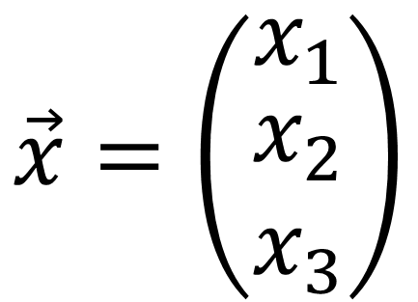

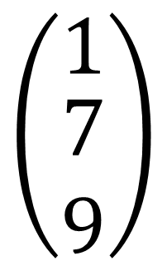
Vector
$$x_{i}$$
Component
Index
$$\vec{x}=\left(\begin{matrix}x_{1} \\ \begin{matrix}x_{2} \\ x_{3}\end{matrix}\end{matrix}\right)$$
$$\left(\begin{matrix}1 \\ \begin{matrix}7 \\ 9\end{matrix}\end{matrix}\right)$$
Column Vector
$$\vec{x}=\left(\begin{matrix}x_{1} & x_{2} & x_{3}\end{matrix}\right)$$
$$\left(\begin{matrix}10 & 7 & 25\end{matrix}\right)$$
Row Vector

Slide 3
Matrix
$$M=\left(\begin{matrix}M_{1,1} & \begin{matrix}M_{1,2} & M_{1,3}\end{matrix} \\ M_{2,1} & \begin{matrix}M_{2,2} & M_{2,3}\end{matrix}\end{matrix}\right)$$
$$M=\left(\begin{matrix}17 & \begin{matrix}5 & 2\end{matrix} \\ 2 & \begin{matrix}4 & 10\end{matrix}\end{matrix}\right)$$
$$M=2×3$$
$$M=ROW×COLUMN$$
$$M=UP×RIGHT$$

Slide 4
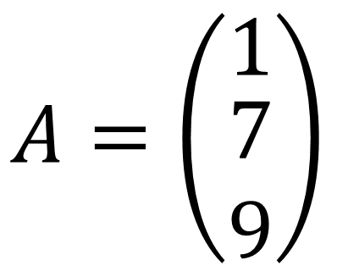
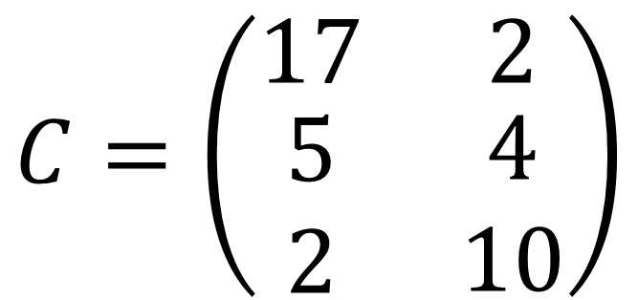
Question
$$A=\left(\begin{matrix}1 \\ \begin{matrix}7 \\ 9\end{matrix}\end{matrix}\right)$$
$$A=3×1$$
$$B=\left(\begin{matrix}10 & 7 & 25\end{matrix}\right)$$
$$B=1×3$$
$$C=\left(\begin{matrix}17 & 2 \\ \begin{matrix}5 \\ 2\end{matrix} & \begin{matrix}4 \\ 10\end{matrix}\end{matrix}\right)$$
$$C=3×2$$

Slide 5
Addition
$$\left(\begin{matrix}17 & \begin{matrix}5 & 2\end{matrix} \\ 2 & \begin{matrix}4 & 10\end{matrix}\end{matrix}\right)+\left(\begin{matrix}4 & \begin{matrix}2 & 3\end{matrix} \\ 1 & \begin{matrix}1 & 7\end{matrix}\end{matrix}\right)=$$
$$=\left(\begin{matrix}17+4 & \begin{matrix}5+2 & 2+3\end{matrix} \\ 2+1 & \begin{matrix}4+1 & 10+7\end{matrix}\end{matrix}\right)$$
$$=\left(\begin{matrix}21 & \begin{matrix}7 & 5\end{matrix} \\ 3 & \begin{matrix}5 & 17\end{matrix}\end{matrix}\right)$$

Slide 6
Subtraction
$$\left(\begin{matrix}17 & \begin{matrix}5 & 2\end{matrix} \\ 2 & \begin{matrix}4 & 10\end{matrix}\end{matrix}\right)−\left(\begin{matrix}4 & \begin{matrix}2 & 3\end{matrix} \\ 1 & \begin{matrix}1 & 7\end{matrix}\end{matrix}\right)=$$
$$=\left(\begin{matrix}17−4 & \begin{matrix}5−2 & 2−3\end{matrix} \\ 2−1 & \begin{matrix}4−1 & 10−7\end{matrix}\end{matrix}\right)$$
$$=\left(\begin{matrix}13 & \begin{matrix}3 & −1\end{matrix} \\ 1 & \begin{matrix}3 & 3\end{matrix}\end{matrix}\right)$$

Slide 7
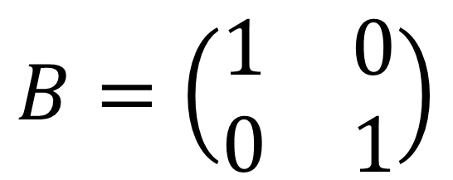
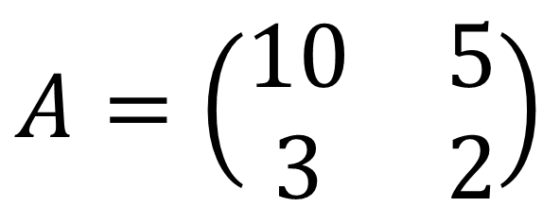
Question
$$A=\left(\begin{matrix}10 & 5 \\ 3 & 2\end{matrix}\right)$$
$$B=\left(\begin{matrix}1 & 0 \\ 0 & 1\end{matrix}\right)$$
$$\left(\begin{matrix}10+1 & 5+0 \\ 3+0 & 2+1\end{matrix}\right)=\left(\begin{matrix}11 & 5 \\ 3 & 3\end{matrix}\right)$$
$$\left(\begin{matrix}10−1 & 5−0 \\ 3−0 & 2−1\end{matrix}\right)=\left(\begin{matrix}9 & 5 \\ 3 & 1\end{matrix}\right)$$

Slide 8
Scalar Multiplication
$M=$ $\left(\begin{matrix}4 & \begin{matrix}2 & 4\end{matrix} \\ 1 & \begin{matrix}1 & 8\end{matrix}\end{matrix}\right)$
$$\frac{1}{4}M=\frac{1}{4}\left(\begin{matrix}4 & \begin{matrix}2 & 4\end{matrix} \\ 1 & \begin{matrix}1 & 8\end{matrix}\end{matrix}\right)=$$
$$=\left(\begin{matrix}0.25∙4 & \begin{matrix}0.25∙2 & 0.25∙4\end{matrix} \\ 0.25∙1 & \begin{matrix}0.25∙1 & 0.25∙8\end{matrix}\end{matrix}\right)=$$
$$=\left(\begin{matrix}1 & \begin{matrix}0.5 & 1\end{matrix} \\ 0.25 & \begin{matrix}0.25 & 2\end{matrix}\end{matrix}\right)$$

Slide 9
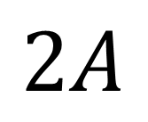
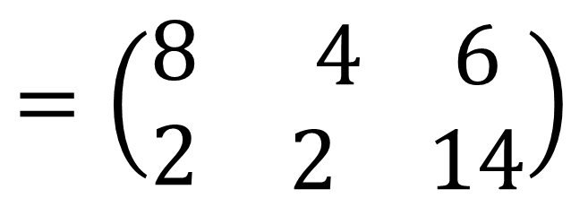
Question
$$A=\left(\begin{matrix}4 & \begin{matrix}2 & 3\end{matrix} \\ 1 & \begin{matrix}1 & 7\end{matrix}\end{matrix}\right)$$
$$=\left(\begin{matrix}8 & \begin{matrix}4 & 6\end{matrix} \\ 2 & \begin{matrix}2 & 14\end{matrix}\end{matrix}\right)$$
$$2A$$

Slide 10
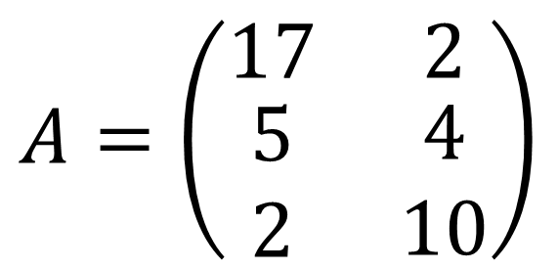
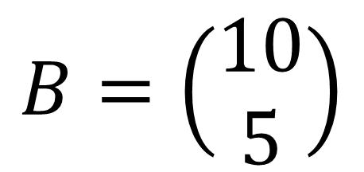
Matrix Multiplication
$$A=\left(\begin{matrix}17 & 2 \\ \begin{matrix}5 \\ 2\end{matrix} & \begin{matrix}4 \\ 10\end{matrix}\end{matrix}\right)$$
$$NOTE! AB≠BA$$
$$B=\left(\begin{matrix}10 \\ 5\end{matrix}\right)$$
$$A=3×2$$
$$B=2×1$$
$$\left(a×b\right)\left(b×c\right)=a×c$$
$$\left(3×2\right)\left(2×1\right)=3×1$$
$(2×1$)$\left(3×2\right)→NOT POSSIBLE$

Slide 11
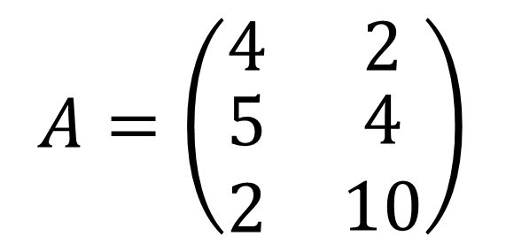
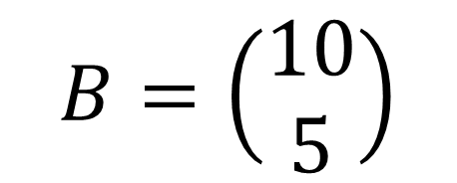
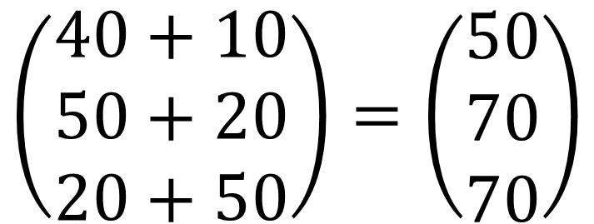
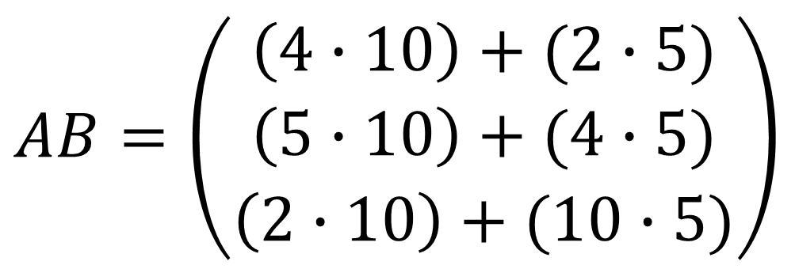
Matrix Multiplication
$$A=\left(\begin{matrix}4 & 2 \\ \begin{matrix}5 \\ 2\end{matrix} & \begin{matrix}4 \\ 10\end{matrix}\end{matrix}\right)$$
$$B=\left(\begin{matrix}10 \\ 5\end{matrix}\right)$$
$$AB=\left(\begin{matrix}\left(4∙10\right)+(2∙5) \\ \left(5∙10\right)+(4∙5) \\ \left(2∙10\right)+(10∙5)\end{matrix}\right)$$
$$\left(\begin{matrix}40+10 \\ 50+20 \\ 20+50\end{matrix}\right)=\left(\begin{matrix}50 \\ 70 \\ 70\end{matrix}\right)$$

Slide 12
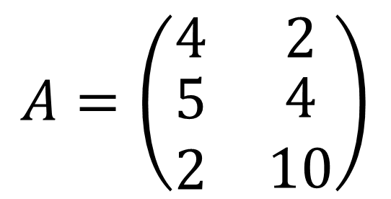
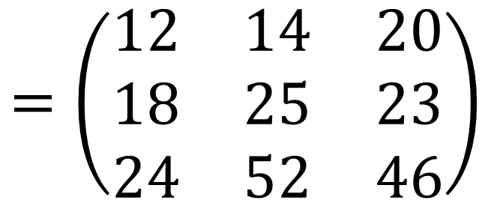
Matrix Multiplication
$$A=\left(\begin{matrix}4 & 2 \\ \begin{matrix}5 \\ 2\end{matrix} & \begin{matrix}4 \\ 10\end{matrix}\end{matrix}\right)$$
$$B=\left(\begin{matrix}2 & 1 & 3 \\ 2 & 5 & 4\end{matrix}\right)$$
$$AB=3×3$$
$$\left(\begin{matrix}\left(4∙2\right)+(2∙2) & \left(4∙1\right)+(2∙5) & \left(4∙3\right)+(2∙4) \\ \left(5∙2\right)+(4∙2) & \left(5∙1\right)+(4∙5) & \left(5∙3\right)+(4∙4) \\ \left(2∙2\right)+(10∙2) & \left(2∙1\right)+(10∙5) & \left(2∙3\right)+(10∙4)\end{matrix}\right)$$
$$\left(\begin{matrix}8+4 & 4+10 & 12+8 \\ 10+8 & 5+20 & 15+8 \\ 4+20 & 2+50 & 6+40\end{matrix}\right)$$
$$=\left(\begin{matrix}12 & 14 & 20 \\ 18 & 25 & 23 \\ 24 & 52 & 46\end{matrix}\right)$$

Slide 13
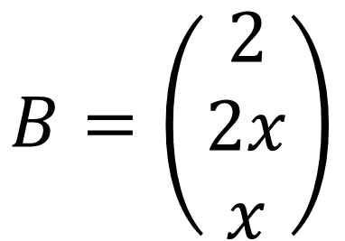
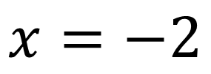
Matrix Multiplication
$$B=\left(\begin{matrix}2 \\ 2x \\ x\end{matrix}\right)$$
$$A=\left(\begin{matrix}10 & 2 & 4\end{matrix}\right)$$
$$Find x when AB=4$$
$$\left(10∙2\right)+\left(2∙2x\right)+\left(4∙x\right)=4$$
$$20+4x+4x=4$$
$$4x+4x=4−20$$
$$8x=−16$$
$$x=−2$$

Slide 14
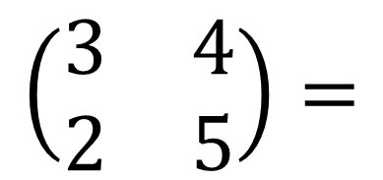

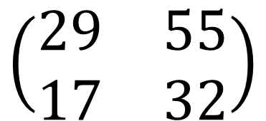
Question
$$AB=\left(\begin{matrix}5 & 7 \\ 3 & 4\end{matrix}\right)$$
$$\left(\begin{matrix}3 & 4 \\ 2 & 5\end{matrix}\right)=$$
$$\left(\begin{matrix}\left(5∙3\right)+(7∙2) & \left(5∙4\right)+(7∙5) \\ \left(3∙3\right)+(4∙2) & \left(3∙4\right)+(4∙5)\end{matrix}\right)=$$
$$\left(\begin{matrix}15+14 & 20+35 \\ 9+8 & 12+20\end{matrix}\right)=$$
$$\left(\begin{matrix}29 & 55 \\ 17 & 32\end{matrix}\right)$$

Slide 15
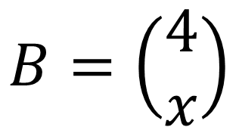
Question
$$B=\left(\begin{matrix}4 \\ x\end{matrix}\right)$$
$$A=\left(\begin{matrix}5 & 2\end{matrix}\right)$$
$$Find x when AB=4$$
$$\left(5∙4\right)+\left(2∙x\right)=4$$
$$20+2x=4$$
$$2x=4−20$$
$$2x=−16$$
$$x=−8$$

