Slide 1
Essays: the basics
PAL workshop by Nauris Kalnins
and Alexander Lee

Slide 2
Workshop outcomes:
An overview of specific requirements and rules to follow.
Understanding of the formal essay structure.
Pointers on how to generate the content of an essay.

Slide 3
Workshop structure:
A general introduction to writing essays.
Q/A with materials to help start an essay.

Slide 4
What is an essay?
“A whole is that which has beginning, middle and end” Aristotle.

Slide 5
Essay structure
Introduction
General statements
Essay statements
Body
1) Counter argument
Conclusion
Restate main points
Final comments
b) Argument
2) Argument
b) Argument
a) Counter Argument
a) Counter argument

Slide 6
Paragraph structure
Point
Make a point about the question with a topic sentence and stick to that topic for your paragraph.
Explain
Explain your point and make it relevant to your question.
Link
Examples
Provide at least two examples to prove your point and argue your case.
Link your information back to the question and wrap up your paragraph with a concluding sentence.

Slide 7
Sentence structure
One topic per sentence.
Keep the main question clear.
Use connecting sentences and linking words to keep the flow.
No overly long sentences.
Read what you write out loud.

Slide 8
Citation/paraphrasing
It is apparent that “Harvard is the referencing system of choice in the University of Sussex” (Lee, 2020).
As Kalnins (2020) explained, paraphrasing clearly demonstrates to the graders an understanding of the topic in question.
Reference list:
Kalnins, N. and Lee, A., 2020. Essays: the basics. [online] PAL. Available through: University of Sussex Canvas website <https://canvas.sussex.ac.uk/courses/14865/modules> [Accessed 16 October 2020].

Slide 9
Rules for text:
Font - any clear and readable.
Font size - 12.
Line spacing - 2.
Follow the word count +/-10%.

Slide 10
What you need to start:
General knowledge of the topic
Obtained by engaging the course material through lectures and readings
Lecture/reading notes
Depending on the note taking style, these should provide enough references to fill out an essay.
Grading rubric
Provides a specification for your essay.
Highlights specific requirements you need to fulfil.

Slide 11
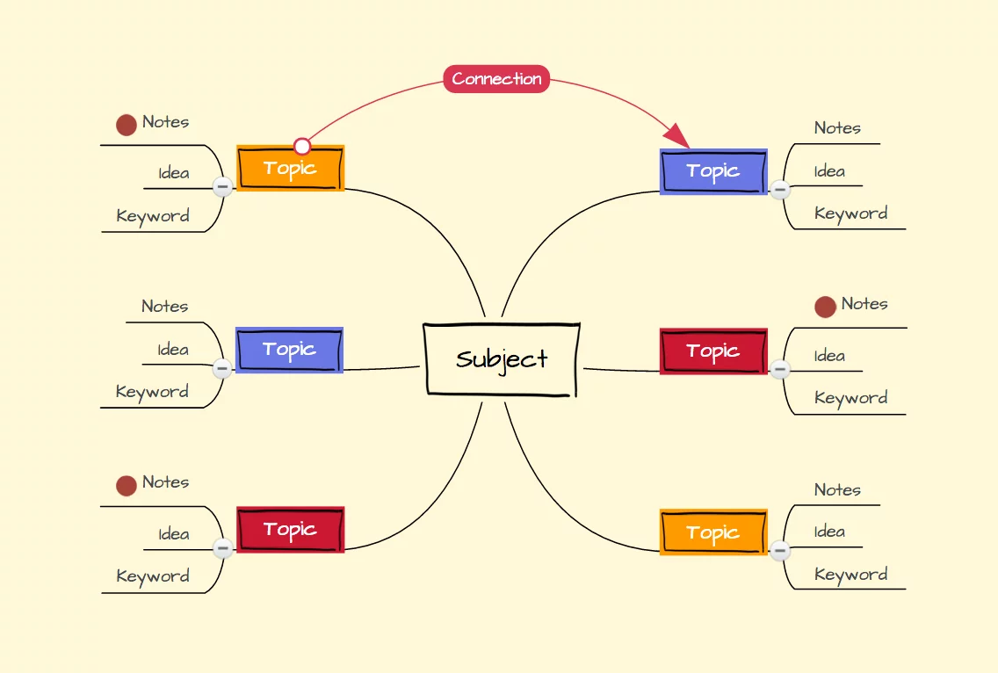
Example: Mind maps

Slide 12
Example progression:
Thesis: a formal statement illustrating a point.
Antithesis: a formal statement that contradicts or negates the first statement.
Synthesis: resolves the conflict between the first and the second statements.

Slide 13
Essay resources:
General help with essays:
http://www.sussex.ac.uk/skillshub/
Referencing:
https://library.aru.ac.uk/referencing/harvard.htm
Advanced essay writing:
http://www.jimpryor.net/teaching/guidelines/writing.html
https://hwpi.harvard.edu/files/hwp/files/philosophical_writing.pdf
https://docs.google.com/viewer?url=http://jordanbpeterson.com/wp-content/uploads/2018/02/Essay_Writing_Guide.docx

